Slide 1
Developing Compatible Software for Windows 7
Maarten van de Bospoort
Application Development Consultant
Microsoft Premier Services
maartenb@microsoft.com

Slide 2
Agenda
Windows Application Compatibility Roadmap
Top Compatibility Issues XP → Win 7
Compatibility Issues Vista → Win 7
Next Steps

Slide 3


Windows 7 Builds on Windows Vista
Deployment, Testing, and Pilots Today Will Continue to Pay Off
Windows 7
  Few Changes: Most software that runs on Windows Vista will run on Windows 7 - exceptions will be low level code (AV, Firewall, Imaging, etc).
  Hardware that runs Windows Vista well will run Windows 7 well.
Few Changes: Focus on quality and reliability improvements
Deep Changes: New models for security, drivers, deployment, and networking

Slide 4
Top AppCompat Issues
Moving from XP to Win 7
  User Account Control
  Services Isolation
Moving from Vista to Win 7
  Version checking
  High DPI
  Low level binary changes

Slide 5
User Account Control – Why?
Applications run as Standard User by default
What is a Standard User?
  Allowed
  Run most applications
  Change per user settings
  Not Allowed
  Install applications
  Change system components
  Change per machine settings
  Admin “privileges”

Slide 6




UAC Architecture
Admin Token
App
Admin Token
Abby
Child App
Admin Token
“Standard User” Token
Standard User Token
Standard User Token
App
Standard User Token
Child App

Slide 7
The Split Token
Run with fewer rights most of the time
Conveniently elevate when you need rights
Applies to interactive logons only

Slide 8
UAC Split Tokens
demo

Slide 9
Mandatory Integrity Control (MIC)
Traditional NT security model revolves around process token
Windows Vista/Win7 enhances this with MIC:
  Each process gets a MIC level
  All resources get a MIC level (medium is default)
There are four levels:
  0: Low
  1: Medium
  2: High
  3: System

Slide 10
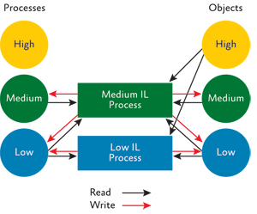
MIC and Securable Objects

Slide 11
Mandatory Integrity Levels
demo

Slide 12
Prior to Vista
IExplore.exe
Admin-Rights Access
Install an ActiveX
control
HKLM
Program Files
Exploit can install MALWARE
User-Rights Access
Change Settings,
Download a Picture
HKCU
My Documents
Startup Folder
Exploit can install MALWARE
Temp Internet Files
Cache Web content
Untrusted files & settings
Notes:
NEW SLIDE w/ Animations

Slide 13
Vista+ Protected Mode
Protected
Mode
IE
Integrity Control
Broker Process
Compat Redirector
Admin-Rights Access
Install an ActiveX control
HKLM
HKCR
Program Files
Broker Process
User-Rights Access
Change settings,
Save a picture
HKCU
My Documents
Startup Folder
Temp Internet Files
Cache Web content
Untrusted files & settings
Redirected settings & files

Slide 14
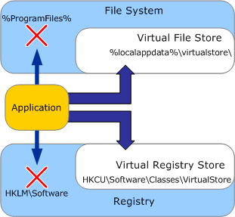
Data Redirection
This is a intended for existing legacy applications and will be removed in a future OS version
32-bit legacy interactive applications that write to administrator locations
    HKLM\Software;
    %SystemDrive%\Program Files
    %WinDir%\System32
Redirected to:
    HKCU\Software\Classes\VirtualStore
    %LocalAppData%\VirtualStore\
Redirection removes need for elevation
  Writes to HKLM go to HKCU redirected store
  Writes to system directories redirected to per-user store
When running 32-bit applications on x64, WOW64…

Slide 15
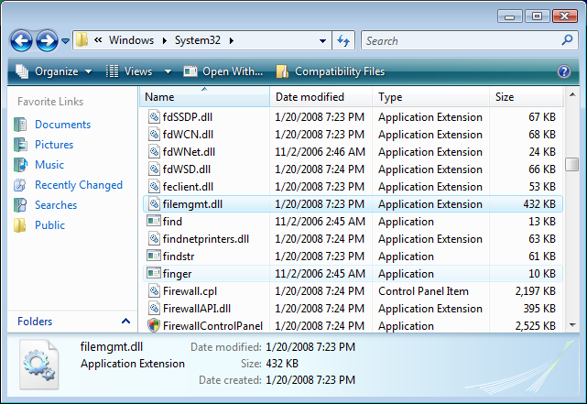
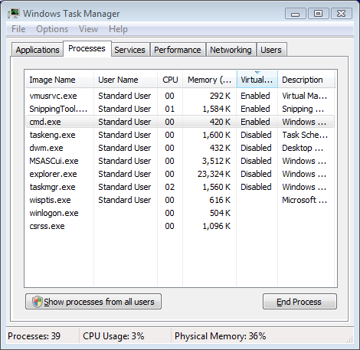
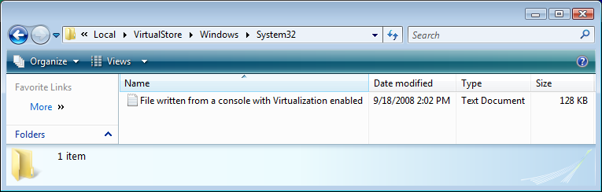
Data Redirection and explorer

Slide 16
Data Redirection
demo

Slide 17
Installer Detection

Slide 18
Vista / Win 7 “Aware” Application
Vista/Win 7-aware applications embed an XML manifest
Disables all mitigations
Manifest contains a RequestedExecutionLevel:
asInvoker | Launch with the same token as the parent process
highestAvailable | Launch with the highest token this user possesses
requireAdministrator | Highest token of the User provided User is a member of Administrators group
Notes:
18

Slide 19
UAC Manifest
MyAdminApp.Exe.Manifest
<?xml version="1.0" encoding="UTF-8" standalone="yes"?>
<assembly xmlns="urn:schemas-microsoft-com:asm.v1" manifestVersion="1.0">
<assemblyIdentity version="1.0.0.0"
processorArchitecture="X86"
name="MyAdminApp"
type="win32"/>
<!-- Identify the application security requirements. -->
<trustInfo xmlns="urn:schemas-microsoft-com:asm.v3">
<security>
<requestedPrivileges>
<requestedExecutionLevel level="requireAdministrator"/>
</requestedPrivileges>
</security>
</trustInfo>
</assembly>
Notes:
19

Slide 20
Finding/Solving UAC Issues
Do you?
  Write to Program Files, Windows, System32, HKLM/Software, or Root?
  Create anything “globally”
  UseWindows messages between isolation levels
Try
  Running the application “As Administrator”
  Testing with UAC off
Tools
  Process Monitor
  Standard User Analyzer

Slide 21
Sessions in XP/W2K/WS03
Session 0
Window Station
Desktop
Services
Shatter Attack
1st User’s
Window
1st User’s
Window
1st User’s
Window
Screen Saver
Login
Notes:
4/21/2009 10:20 AM
21

Slide 22
Sessions in Vista/Windows 7
Session 0
Session 1
Window Station
Window Station
Desktop
Desktop
Service
1st User’s
Window
Service
1st User’s
Window
1st User’s
Window
Screen Saver
Login
Secure
Notes:
4/21/2009 10:20 AM
22

Slide 23
Session 0 Isolation
demo

Slide 24
Finding/Solving Session 0 Issues
Do you?
  Have services that interact with the desktop
  Create a global memory mapped file to communicate
Try
  Verifying communication between services an applications
  Verifying services are not relying on interacting with desktop
Guidance
  For UI, use WTSSendMessage() or CreateProcessAsUser()
  If using mapped files, have the service create it

Slide 25
The AppCompat “Cookbooks”
Everything else that we haven’t covered
XP-> Vista/2008 -> Win7
  “Application Compatibility Cookbook”
  “Application Compatibility” on MSDN
Vista -> Win 7
  “Windows 7 Application Quality Cookbook”

Slide 26
Windows Vista to Windows 7
Application Compatibility is a main goal
  Very few breaking changes
If your app works on Vista, it will likely work on Windows 7
…but there are a few things to verify

Slide 27
Incompatible by Design
Version checking for a specific OS release
Structure of private data and data types
Patching OS calls
Using Registry Values instead of APIs
Non deterministic Events
Redistributing Windows Updates
Device Drivers without hardware

Slide 28
Version Checking
Applications check Windows OS version and block themselves
  If absolutely needed, check for >= OS version
    Don’t block.
    Present a warning message
    Allow applications to continue
  Check for existence of specific features if that is important
Windows 7 is version 6.1

Slide 29
Version Checks – Stop doing this
LPCWSTR lpwzDll = NULL;
OSVERSIONINFOW osvi;
ZeroMemory(&osvi, sizeof(osvi));
osvi.dwOSVersionInfoSize = sizeof(osvi);
if (!GetVersionEx(&osvi)) { return FALSE; }
// Determine which dll to load
if (osvi.dwMajorVersion >= 5 && osvi.dwMinorVersion >= 1) {
lpwzDll = L"Apphelp.dll"; // XP and newer OS, use Apphelp
} else if (osvi.dwMajorVersion == 5 && osvi.dwMinorVersion == 0) {
lpwzDll = L“SdbApiu.dll"; // Windows 2000, use sdbapiu
} else {
lpwzDll = L“SdbApi.dll"; // Older Version, use sdbapi
}
return LoadLibraryFromSystem32(lpwzDll);

Slide 30
Do This:
HMODULE hMod;
hMod = LoadLibraryFromSystem32(L"Apphelp.dll");
if (hMod) return hMod;
hMod = LoadLibraryFromSystem32(L"sdbapiu.dll");
if (hMod) return hMod;
hMod = LoadLibraryFromSystem32(L"sdbapi.dll");
if (hMod) return hMod;
Notes:
Check for availability of a feature.

Slide 31
New Low-Level Binaries
To improve the foundations of Windows, we have reorganized
Example: functionality from kernel32.dll and advapi32.dll moved to kernelbase.dll
Exported functions are forwarded
Applications depending on offsets and undocumented APIs can break
Guidance:
  Rewrite to use documented APIs

Slide 32
Miscellaneous Regressions
Removal of Windows Mail
Removal of Windows Movie Maker
NLS Sorting Changes
Internet Explorer 8 - User Agent String
Removal of Windows Registry Reflection
Removal of WPDUSB.SYS Driver for Windows Portable Devices
Microsoft Message Queuing (MSMQ)

Slide 33
Making it Better
High DPI
Remote Desktop

Slide 34
High DPI
Windows 7 clean install determines DPI by heuristics
Try
  Running with at least at a DPI of 125%
Guidance
  Fix issues and declare you are DPIAware

Slide 35
This Was Very Surprising To Us…
Monitor Max Resolution | % Set to Maximum
1280X1024 | 56%
1400X1050 | 79%
1600X1200 | 32%
1680X1050 | 66%
1920X1050 | 39%
1920X1200 | 78%
Avg. set to default | 55%
Details
Users with Max Resolution of 1600X1200
User's Chosen Resolution | % using that resolution
640X480 | 1%
800X600 | 7%
1024X768 | 57%
1280X1024 | 3%
1600X1200 | 32%
Total | 100.00%
Almost half of all of users are not configuring their display to maximum resolution (!)
Users are lowering their screen resolution to get larger text…

Slide 36

Why Do We Care?
Non-native resolution negates the value of high fidelity displays
Text looks blurry because ClearType requires native resolution
Can’t display native high def content
  720p high definition video requires 1280x720 resolution
  1080p requires 1920x1080
  1.9 megapixel photos requires 1600x1200 native
Many people accidentally select a non-native aspect ratio
Pixilated Content does not take advantage of the display
Non-native aspect Ratio Settings “Squishes” Content

Slide 37
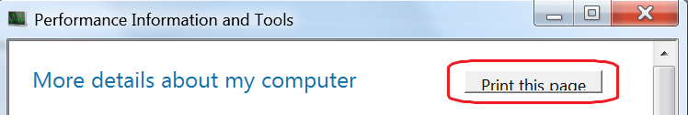
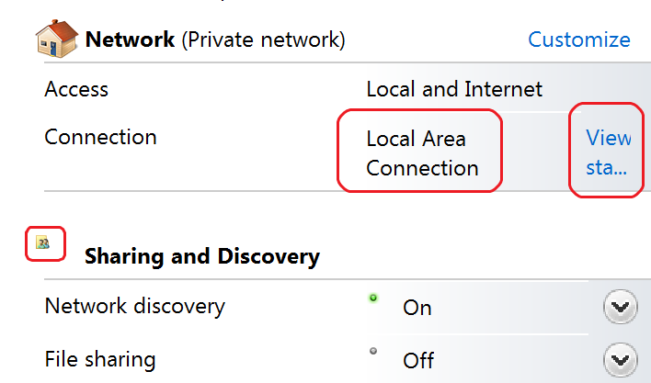
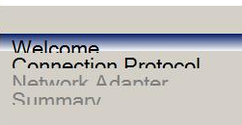
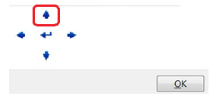
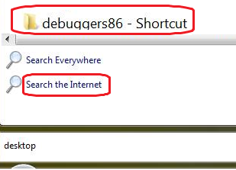
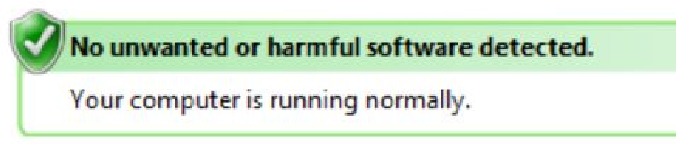
High DPI Issues
Clipped Text
Layout Issues & Image Size Issues
WinForms Issues
Pixilated Bitmaps
Blurry UI
Mismatched Font Sizes

Slide 38
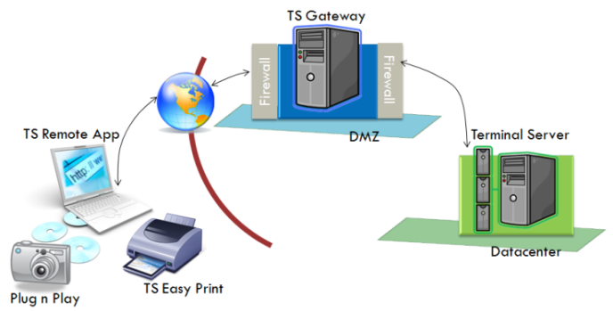
What is TS or RDS?
Terminal Services which would in future be called “Remote Desktop Services” allows -
  Central deployment of applications
  Users to connect to the Remote Desktop Server
    Run their applications
    Save their data
    Use network resources etc.
  Users to access just an application or the full desktop remotely
    TS Remote App brings rich remote application experience integrated into your desktop
    Application hosting - TS Web Access + TS Remote App

Slide 39
RDP Compatibility issues
Concurrent usage
  Write to user profile
  Use local TS session, not global
User data privacy
Remote devices
  Local Disk drives, printers etc. are remote to the application
Performance considerations
  Careful with paints, non-essential video
  Optimize disk I/O, CPU, network

Slide 40
Shims for ISVs?
Windows components change to support:
  New technology
  Bug fixes
  Strategy changes
OS changes may fix some, break others
Simulate previous Windows ONLY for an app

Slide 41
Application Shim Technology
“Shim Technology is an elegant technique that is used to fool some applications into running on versions of the operating system they may not have been designed for. It’s a method of 'hooking' the Win32 APIs that are called by a particular application program. Once installed, such hooks permit developers and support engineers to install alternate (stub) functions to be called in place of the original functions. The actions taken by the stub function comprise the fix for a particular application compatibility problem.”
  - Mark Derbecker

Slide 42
Next Steps
Start testing now on the beta
Reference the Cookbooks
Work with your TAM to come to the Readiness Labs or to engage the AppCompat consultants for assistance.

Slide 43
Shim Application
Implements Windows API hooks
Shim engine is responsible for applying the shims
Load the shim DLL
Retrieve the APIs which should be hooked
Review the import table of the application to determine where hooks should be placed
Overwrite the addresses of the API calls with the address in the shim
Notes:
Note: some applications will actively block efforts to shim, so this will not work.

Slide 44
How Shims are Loaded
Shims are applied per executable
Loader maps
executable
and statically
linked DLLs
into memory
Shim engine
applies
API hooks
Run initialization
routines

Slide 45
Logo

Slide 46
Resources
Cookbooks
  “Application Compatibility Cookbook”
  “Windows 7 Application Quality Cookbook”
MSDN Application Compatibility: http://msdn.microsoft.com/en-us/windows/aa904987.aspx
TechNet Windows Application Compatibility: http://technet.microsoft.com/en-us/desktopdeployment/bb414773.aspx
DevReadiness.org
Channel 9: http://channel9.msdn.com/tags/Application+Compatibility/

Slide 47
Q & A

