Slide 1

Windows 7 Training

Slide 2
Windows® Sensor and Location Platform
Name
Title
Microsoft® Corporation

Slide 3
Agenda
Introduction to the Windows Sensor and Location Platform
Sensor architecture
Working with the Sensor API
Location architecture
Working with the Location API

Slide 4
Sensor Platform Overview
Windows 7 features a new API for working with sensors
  COM-based API
  Works with drivers using the sensor class extension
Benefits
  No need to target vendor-specific APIs or to know hardware specifics
  Consistent interface for all sensor types
  Privacy and security

Slide 5
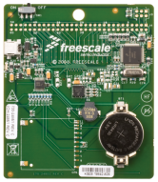
Sensor Platform Architecture
Application
Application
Sensor API
User
Location and Other Sensors Control Panel
System
Sensor class extension
UMDF sensor driver
This is a partial diagram of the Sensor and Location Platform, showing only sensor-related parts
Sensor
device

Slide 6
Sensor API Architecture
COM-based API (includes Sensorsapi.h and Sensors.h)
Consists of these main interfaces:
  ISensorManager
    Sensor enumeration, attachment event, request permissions
  ISensor
    Get and set properties, get report, events (new report, detachment, state change, custom) and more
  ISensorDataReport
    Get sensor data report data fields

Slide 7
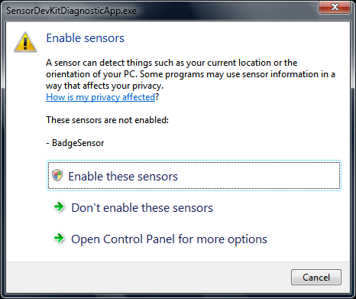
Privacy and Access Control
Location data is considered personally identifiable information (PII)
  User consent is required to share data
All sensors are disabled by default
Administrator rights required to enable a sensor
Sensors can be
configured on a
per-user basis
Enable Sensors
dialog box
invoked by
applications

Slide 8
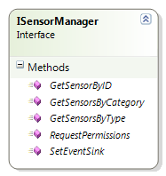
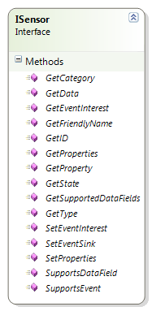
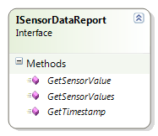
Sensor API Architecture

Slide 9
What Is a Sensor?
Enumerated via category and type GUIDs
  Category represents what is being sensed (for example, environment, location, motion, electrical systems)
  Type represents how it is being sensed (for example, by thermometer, GPS, accelerometer, voltage)
Properties
  Read-only (such as model) or read-write (such as report interval).
  Sensors may have custom properties
Data
  Get (sensor-specific) data report object synchronously (not recommended) or asynchronously (events)
Events
  State change, leave (detach), data updated, custom
State
  Is sensor working properly? Do you have access?

Slide 10
Enumerating Sensors
#include <sensorsapi.h>
#include <sensors.h>
HRESULT hr;
CComPtr<ISensorManager> pSensorManager;
pSensorManager.CoCreateInstance(CLSID_SensorManager);
CComPtr<ISensorCollection> pALSCollection;
CComPtr<ISensor> pALSSensor;
// Get all the ALS sensors on the system
pSensorManager->GetSensorsByType(SENSOR_TYPE_AMBIENT_LIGHT, &pALSCollection);
hr = pSensorManager->RequestPermissions(
0, // Owner window
pALSCollection, // Collection of sensors requiring permissions
TRUE); // Modal flag
if(SUCCEEDED(hr))
{
pALSCollection->GetAt(0, &pALSSensor);
}

Slide 11
Getting Current Light Level
STDMETHODIMP CALSEventSink::OnDataUpdated(
ISensor* pSensor, ISensorDataReport* pNewData)
{
  PROPVARIANT lightLevel;
  PropVariantInit(&lightLevel);
  // Get the sensor reading from the ISensorDataReport object
  pNewData->GetSensorValue(SENSOR_DATA_TYPE_LIGHT_LEVEL_LUX, &lightLevel);
  // Extract the float value from the PROPVARIANT object
  float luxValue = V_FLOAT(lightLevel);
  // Normalize the light sensor data
  double lightNormalized = ::pow(luxValue, 0.4) / 100.0;
  // Handle UI changes based on the normalized LUX data
  // which ranges from 0.0 - 1.0 for a lux range of
  // 0 lux to 100,000 lux, this method represents such a
  // handler that would be implemented in your application UpdateUI(lightNormalized);
  PropVariantClear(&lightLevel);
  return S_OK;
}

Slide 12
Windows 7 Integration Library
Managed class library to ease .NET Framework access to Windows 7® features
  Taskbar, Libraries, Sensor, Location, Multi-Touch, UAC, power management, restart and recovery, network awareness, Aero Glass and more.
It is a sample library not a full product
  Open source with no support
  Use at your own risk

Slide 13
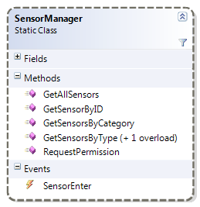
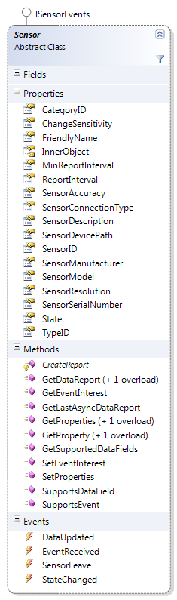
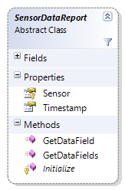
Sensor Wrapper Architecture
The three classes retain the same roles as they had in the COM API, only wrapping properties and events

Slide 14
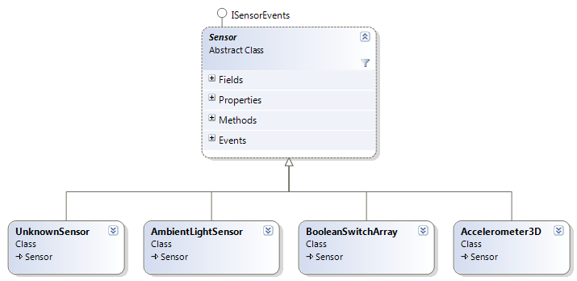
Sensor Wrapper Architecture
Sensor is an abstract base class with a derived type for each sensor type
  Derived types can add properties and events

Slide 15
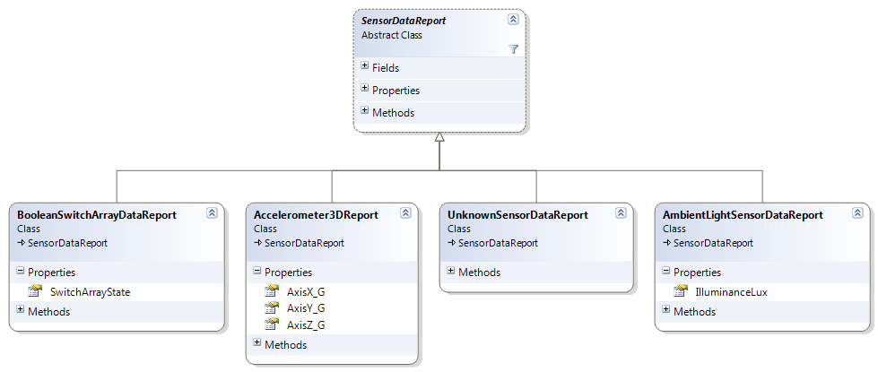
Sensor Wrapper Architecture
SensorDataReport also has a derived type for each sensor type
  Provides a strongly-typed way to access data

Slide 16
Enumerating Sensors
Accelerometer3D[] sensors =
SensorManager.GetSensorsByType<Accelerometer3D>();
Accelerometer3D a3dSensor = null;
if (sensors.Length > 0)
{
a3dSensor = sensors[0];
SensorManager.RequestPermission(IntPtr.Zero, true,
a3dSensor);
}

Slide 17
Receiving Data Reports from Sensor
a3dSensor.DataUpdated += OnDataUpdated;
void OnDataUpdated(Sensor sensor, SensorDataReport
dataReport)
{
Accelerometer3DReport a3dReport =
(Accelerometer3DReport)dataReport;
Console.WriteLine("X: {0} Y: {1} Z: {2}",
a3dReport.AxisX_G, a3dReport.AxisY_G,
a3dReport.AxisZ_G);
}

Slide 18
Location Platform Overview
The Windows 7 Location API is built on top of the Sensor API
  COM-based API (includes Locationapi.h)
  It is a high-level abstraction
Leverages sensors which provide location information
  Some sensors (location providers) may be logical
    Wi-Fi hotspot triangulation

Slide 19

Sensor and Location Platform Architecture – The Big Picture
Gadget or script
Application
Application
Location IDispatch Interface
Location API
Sensor API
User
Location and Other Sensors Control Panel
System
Sensor class extension
Sensor class extension
UMDF sensor driver
UMDF sensor driver
Logical location sensor
(Triangulation)
Sensor
device

Slide 20
Location Platform Benefits
Single API call to answer “Where am I?”
  Provider (such as: GPS, IP resolver, Wi-Fi) independent
  Synchronous and asynchronous models
  Script or automation compatible
Automatic transition between providers
  Most accurate providers have priority
Concurrent access for multiple applications
Default location
  Provided by user as fallback when no other sources are available

Slide 21
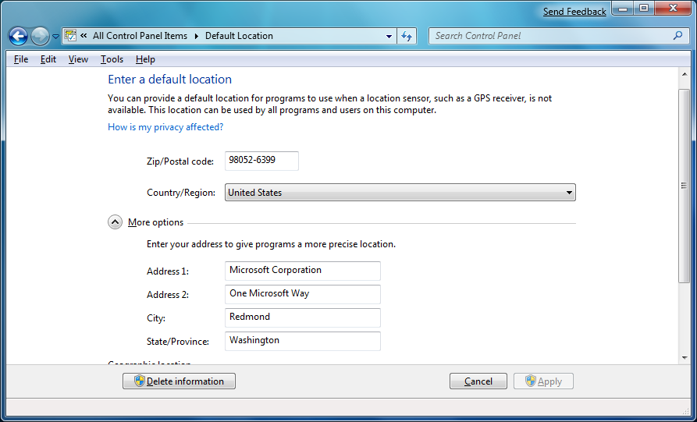
Default Location in Control Panel

Slide 22
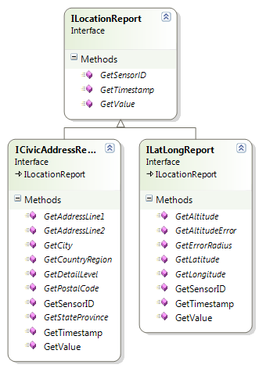
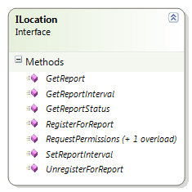
Location API Architecture
Consists of four main interfaces
  ILocation – Get location report (synchronous), query status, register for notification (asynchronous), request permissions
  ILocationReport – Base interface; Two derived types exist: ILatLongReport and ICivicAddressReport

Slide 23
Location API Architecture
ILocation Methods
Method | Description
GetReport([in] REFIID reportType, [out] ILocationReport *ppLocReport) | Synchronously retrieves location report by report type. ILocationReport is a base type.
GetReportStatus([in] REFIID reportType, [out] LOCATION_REPORT_STATUS *pStatus) | Retrieves status for specified report type.
RequestPermissions([in] HWND hParent, [in] IID *pReportTypes, [in] ULONG count, BOOL fModal) | Opens a dialog to request user permission for sensors providing the given report types.
RegisterForReport([in] ILocationEvents *pEvents, [in] REFIID reportType, [in] DWORD dwMinReportInterval) | Subscribes a user object implementing ILocationEvents to asynchronously receive reports of the specified type.
UnregisterForReport([in]REFIID reportType) | Stops event notifications for the specified report type.
GetReportInterval([in] REFIID reportType, [out] DWORD *pMilliseconds) | Gets current minimal time (max. frequency) between events.
SetReportInterval([in] REFIID reportType, [in] DWORD milliseconds) | Sets minimal time (max. frequency) between events.

Slide 24
Location API Architecture
ILocationEvents Methods
Method | Description
OnLocationChanged([in] REFIID reportType, [in] ILocationReport *pLocationReport ) | Called when a new location report is available. ILocationReport is a base type of the actual type.
OnStatusChanged([in] REFIID reportType, [in] LOCATION_REPORT_STATUS newStatus ); | Called when a report status changes.

Slide 25
Location API Architecture
ILocationReport (Base Class) Methods
Method | Description
GetSensorID([out] SENSOR_ID *pSensorID) | Retrieves the instance ID of the sensor that generated the location report.
GetTimestamp([out] SYSTEMTIME *pCreationTime ) | Retrieves the date and time when the report was generated.
GetValue([in] REFPROPERTYKEY pKey, [out] PROPVARIANT *pValue) | Retrieves a property value from the location report.

Slide 26
Location API Architecture
Report Statuses (Enumeration)
LOCATION_REPORT_STATUS enumeration:
Value | Description
REPORT_NOT_SUPPORTED | The requested report type is not supported by the API.
REPORT_ERROR | There was an error when creating the report.
REPORT_ACCESS_DENIED | No permissions have been granted to access this report type. Call ILocation::RequestPermissions.
REPORT_INITIALIZING | The report is being initialized.
REPORT_RUNNING | The report is running.

Slide 27
Location API Architecture
IDefaultLocation
Used to set default location (just like the Control Panel applet does) or specifically get the default location.
Method | Description
GetReport([in] REFIID reportType, [out] ILocationReport **ppLocationReport) | Retrieves the specified report type from the default location provider.
SetReport([in] REFIID reportType, [in] ILocationReport *pLocationReport) | Specifies the default location.

Slide 28
Types of Location Data
Geographic data (ILatLongReport)
  Latitude, longitude, altitude,
  associated error required
  Most common format
  Best format for precise location
  Can reverse geo-code later
Civic address (ICivicAddressReport)
  Zip code, country required
  Most human readable
  Best for ‘rough’ location estimates,
  street directions

Slide 29
Getting a Location Report
HRESULT hr;
IID civicReportIID = IID_ICivicAddressReport;
CComPtr<ILocation> pLocation;
CComPtr<ILocationReport> pReport;
hr = pLocation.CoCreateInstance(CLSID_Location);
hr = pLocation->RequestPermissions(0, &civicReportIID, 1, TRUE);
hr = pLocation->GetReport(civicReportIID, &pReport);
CComPtr<ICivicAddressReport> pCivicAddressReport;
pReport.QueryInterface<ICivicAddressReport>(&pCivicAddressReport);
BSTR str;
hr = pCivicAddressReport->GetCountryRegion(&str);
_tprintf(_T("Country/region: %s\n"), str);
SysFreeString(str);

Slide 30
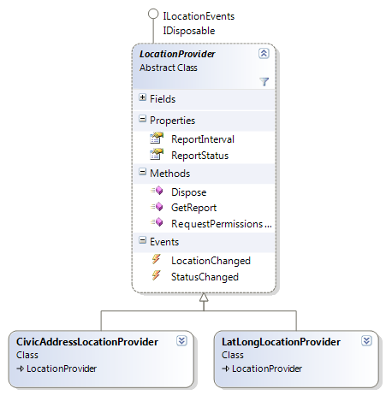
Location Wrapper Architecture
Consists of two main classes: LocationProvider and LocationReport
Instantiate a LocationProvider-derived type (for example, LatLongLocationProvider).
C’tor expects minimum report interval.
Query status via ReportStatus.
If necessary, call RequestPermissions static method.
GetReport() synchronously, or
Subscribe to LocationChanged event.

Slide 31
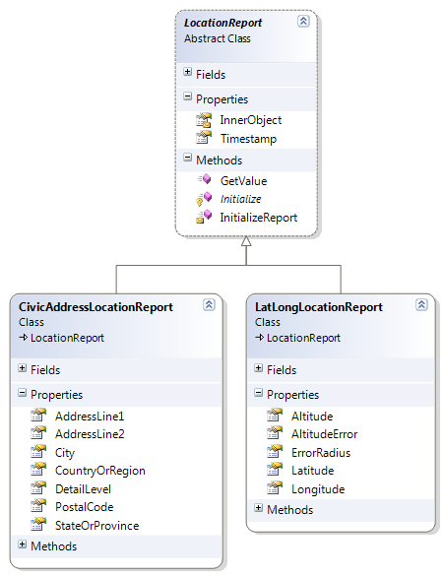
Location Wrapper Architecture
LocationReport is the actual object containing data
Cast the LocationReport type you got from GetReport() or in LocationChanged delegate to the appropriate derived type.
Query properties to retrieve the desired information.

Slide 32
Using Location Wrapper
Synchronous
var provider = new CivicAddressLocationProvider(10000);
LocationProvider.RequestPermissions(IntPtr.Zero,
true, provider);
var report = (CivicAddressLocationReport)
provider.GetReport();
Console.WriteLine("Country/region: “, report.CountryOrRegion);

Slide 33
Using Location Wrapper
Asynchronous
var provider = new CivicAddressLocationProvider(10000);
LocationProvider.RequestPermissions(IntPtr.Zero,
true, provider);
provider.LocationChanged += (LocationProvider prov,
LocationReport newLoc) =>
{
var civicLocReport = (CivicAddressLocationReport) newLoc;
Console.WriteLine("Country/region: ",
civicLocReport.CountryOrRegion);
};

Slide 34
Summary
Platform overview
Native Sensor API
Managed Sensor API wrapper
  Custom sensors
Native Location API
Types of location data, default location
Managed Location API wrapper

Slide 35
Sensors and Location
Q & A
…everything you were afraid to ask

Slide 36
Sensors and Location
hands-on lab
It is time to race

Slide 37

© 2007 Microsoft Corporation. All rights reserved. Microsoft, Windows, Windows Vista and other product names are or may be registered trademarks and/or trademarks in the U.S. and/or other countries.
The information herein is for informational purposes only and represents the current view of Microsoft Corporation as of the date of this presentation. Because Microsoft must respond to changing market conditions, it should not be interpreted to be a commitment on the part of Microsoft, and Microsoft cannot guarantee the accuracy of any information provided after the date of this presentation.
MICROSOFT MAKES NO WARRANTIES, EXPRESS, IMPLIED OR STATUTORY, AS TO THE INFORMATION IN THIS PRESENTATION.

