Slide 1

Windows 7 Training

Slide 2
Windows® 7 Multi-Touch Support
Name
Title
Microsoft® Corporation

Slide 3
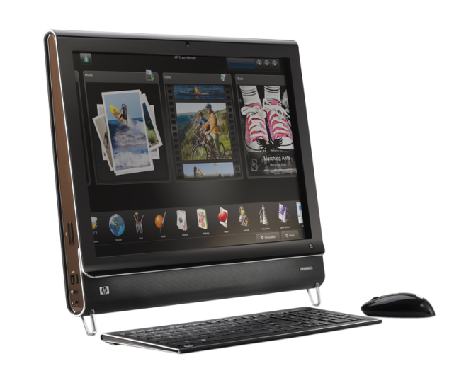
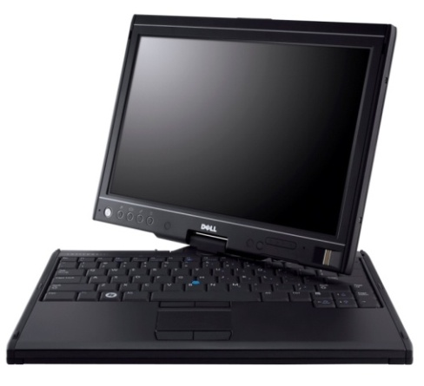
Multi-Touch Is Here!
Hardware
  Multi-touch capable PCs on the market today; multi-touch appears in a broad set of form factors
Software
  Windows 7, .NET Framework 4.0
Consumers
  New scenarios, next wave of user experience, high “WOW” factor

Slide 4
Windows Photo Viewer
Paint
Demo
Windows 7 built-in multi-touch

Slide 5
Agenda
Multi-touch overview
Control Panel settings
Touch scenarios, “Good, Better, Best” model
Platform details
  Native Win32 gesture and touch support
  Manipulations and inertia
  Windows Presentation Foundation (WPF) support
UX guidelines for touch applications
Summary

Slide 6
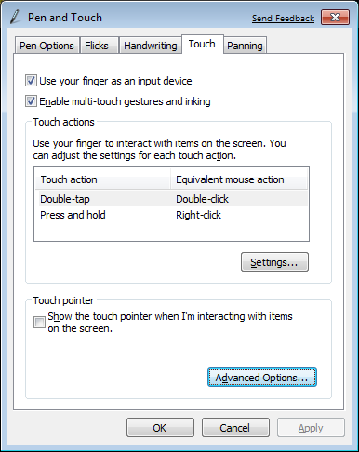
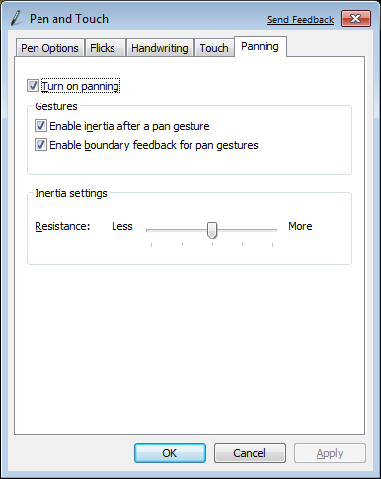
Control Panel: Pen and Touch

Slide 7
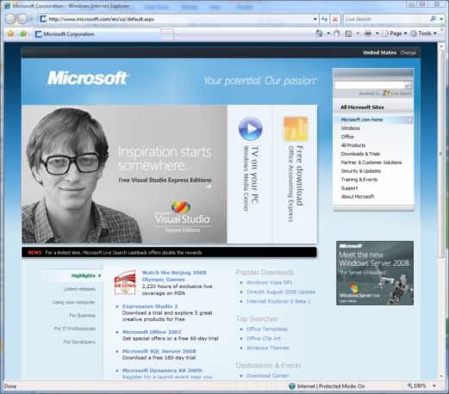
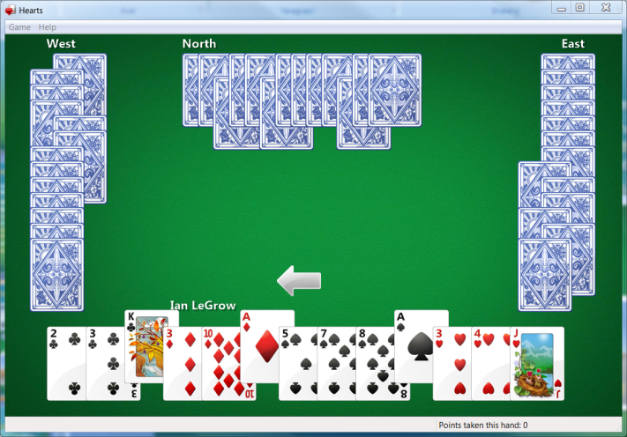

Touch Scenarios and Windows 7
Developer Platform: At the root is the touch developer platform that exposes touch APIs for any application
UI Enhancements: Focusing on the core scenarios, many parts of the core UI have been optimized for touch experiences
Gestures: Multi-touch gestures have been added to enable consistent panning and zooming in most applications.
Applications: A set of multi-touch focused applications that demonstrate the power of touch will ship separately from Windows 7
There are several key scenarios for multi-touch:
Navigating and consuming the Web
Reading and sorting email
Viewing photos
Playing casual games
Consuming music and video
Navigating files and arranging windows
Using Microsoft Office applications
All focused on consumption

Slide 8
Multi-Touch Software
Good – Better – Best
Windows application can target one of three levels of touch integration
  Good: No specific touch APIs are used but the application UI is appropriately sized and
  works well with the built-in gestures
  Better: The gesture APIs are supported to give
  smooth natural interactions
  Best: Deep touch-focused experiences designed
  to take advantage of multi-touch features

Slide 9

Touch Development Roadmap
Windows 7 Release
NET 4.0 / Surface 2.0 Release
Native
Win32
application
WinForms application
WPF application
Surface application
Surface SDK
1.0
Surface SDK 2.0
Surface
multi-touch controls and API
Multi-touch controls
Multi-touch API
Managed wrapper and interoperability
WPF 3.5 SP1
WPF 4.0
Managed wrapper and interoperability
WPF 3.5
Multi-touch API and controls
Surface Hardware
Windows 7
Windows 7
Surface hardware
Windows Vista
Multi-touch API

Slide 10
mtPiano, mtPong
Demo
Best – Touch-based applications

Slide 11
 | Good | Better | Best
APIs | For Free! Panning/zoom gestures Right-click gesture | Gesture notifications Pan/zoom/rotate and so on | Raw touch data Manipulation and inertia processors
Native Win32 | Controls with standard scrollbars | WM_GESTURE message | WM_TOUCH COM-based manipulation and inertia processors
WPF | WPF 4.0 pan support in ScrollViewer | Gesture events Inertia configuration | Touch events Manipulation and inertia processors
WinForms | Controls with standard scrollbars | WM_GESTURE message via interoperability | Manipulation and inertia processors via COM interoperability

Slide 12
Testing the Digitizer Capabilities
Passing SM_DIGITIZER to GetSystemMetrics() returns a bit field:
0x01 | 0x02 | 0x04 | 0x08 | 0x10 | 0x20 | 0x40 | 0x80 | Bit
Integrated Touch | External Touch | Integrated Pen | External Pen | Reserved | Reserved | Multi input | Stack Ready | Value
// test for touch
int value = GetSystemMetrics(SM_DIGITIZER));
if (value & 0x80){ /* stack ready */}
if (value & 0x40)
{
bMutiTouch = TRUE;/* digitizer is multitouch */
MessageBox(L"Multitouch found", L"IsMulti!", MB_OK);
}
if (value & 0x01){ /* Integrated touch */}

Slide 13
Registering for Touch XOR Gesture Messages
BOOL InitInstance(HINSTANCE hInstance, int nCmdShow)
{
HWND hWnd;
hWnd = CreateWindow(…)
if (!hWnd) return FALSE;
//We will receive WM_GESTURE messages by default
//Calling RegisterTouchWindow stops gesture message
if (bTouchMessages && bMultiTouch)
RegisterTouchWindow(hWnd, 0);
ShowWindow(hWnd, nCmdShow);
UpdateWindow(hWnd);
return TRUE;
}

Slide 14
Win32 Samples
Demo
Windows 7 gesture and touch

Slide 15
Setting Gesture Configuration
By default the application receives all gesture messages expects rotate
  You can configure which gestures will be sent:
  BOOL WINAPI SetGestureConfig(HWND hWnd,
  DWORD dwReserved,
  UINT cIDs,
  PGESTURECONFIG pGestureConfig,
  UINT cbSize)
  This API gets an array of GESTURECONFIG structures
    cbSize is the size of the array, cIDs is the length
  dwReserved should be 0

Slide 16
The GESTURECONFIG Structure
typedef struct _GESTURECONFIG
{
DWORD dwID; //One of GID_* (0, ZOOM, PAN,
// ROTATE, TWOFINGERTAP, ROLLOVER
DWORD dwWant; //One of GC_* (ALLGESTURES,
// ZOOM, PAN, PAN_*, ROTATE,
// TWOFINGERTAP, ROLLOVER
DWORD dwBlock; //Same arguments as dwWant
// but block the message
} GESTURECONFIG, *PGESTURECONFIG;

Slide 17
Configure hWnd To Get All Gestures
GESTURECONFIG gestureConfig;
gestureConfig.dwID = 0;
gestureConfig.dwBlock = 0;
gestureConfig.dwWant = GC_ALLGESTURES;
SetGestureConfig(hWnd, 0, 1,
&gestureConfig,
sizeof(gestureConfig));

Slide 18
Dynamically Changing Gesture Configurations
The WM_GESTURENOTIFY message is sent to indicate that a gesture message is about to be received
case WM_GESTURENOTIFY:
{
GESTURECONFIG gc = {0,GC_ALLGESTURES,0};
SetGestureConfig(hWnd, 0, 1, &gc,
sizeof(GESTURECONFIG));
}
break;

Slide 19
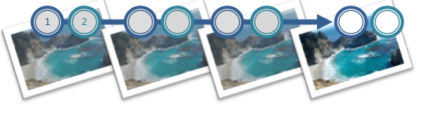
Predefined Gestures – Translate
Place two fingers in the application window and drag in the direction you want
SFP – Single Finger Panning
  SetGestureConfig() for GC_PAN
  Specify GC_PAN_WITH_SINGLE_FINGER_VERTICALLY and/or GC_PAN_WITH_SINGLE_FINGER_HORIZONTALLY

Slide 20
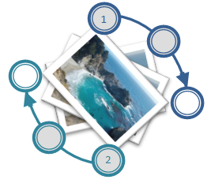
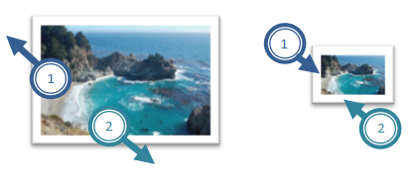
Zoom and Rotate
Rotate
  Touch the image with two
  fingers and turn fingers in
  a circle
Zoom
  Touch the image with
  two fingers and move
  them closer or further
  apart

Slide 21


Two Finger Tap and Finger Roll
Two Finger Tap
  Tap once with both
  fingers
Finger Roll
  Place one finger on the screen, place second finger on the screen, lift the second finger, and then lift the first finger

Slide 22
WM_GESTURE Message
GESTUREINFO gi;
gi.cbSize = sizeof(GESTUREINFO);
gi.dwFlags = 0; gi.ptsLocation.x = 0; …
GetGestureInfo((HGESTUREINFO)lParam, &gi);
// now interpret the gesture
switch (gi.dwID){
case GID_ZOOM:
// Code for zooming goes here
break;
case GID_PAN:
// Code for panning goes here
break;
case GID_ROTATE: …
}
CloseGestureInfoHandle((HGESTUREINFO)lParam);

Slide 23
GESTUREINFO Structure
typedef struct _GESTUREINFO
{
UINT cbSize;
DWORD dwFlags; //GF_* (BEGIN, INERTIA, END)
DWORD dwID; //GID_* (BEGIN, END, ZOOM, PAN,
//ROTATE, TWOFINGERTAP, ROLLOVER)
HWND hwndTarget;
POINTS ptsLocation;
DWORD dwInstanceID;
DWORD dwSequenceID;
ULONGLONG ullArguments; //8 Bytes Gesture Arg
UINT cbExtraArgs;
} GESTUREINFO, *PGESTUREINFO;

Slide 24
Decoding Gesture
(dwFlags & GF_BEGIN) != 0
  Indicates that this is a new gesture
If dwFlags is 0 (or GF_INERTIA)
  For Pan:
    We have to calculate the translation delta since last message
  For Rotate:
    We have to calculate the angle delta since last message
  For Zoom:
    We have to calculate the zoom factor delta since last message

Slide 25
Multi-Touch in .NET Framework
For WPF:
  Interop sample library for .NET Framework 3.5
    Multi-touch, gesture, Inertia, Manipulation
  .NET Framework 4.0 release
    Multi-touch specific new controls
For WinForms (Windows 7 launch):
  Interoperability to native Win32 APIs – TouchWrapper

Slide 26
The Windows Integration Library
Windows7.Multitouch.Handler
  A base class for Touch and Gesture handlers
Use Factory to create one of the handlers
  For WinForm, managed Win32 hWnd, and WPF gesture support the handler subclass the Window (hWnd)
  For WPF touch support, use stylus event with the help of the Factory.EnableStylusEvents() method

Slide 27
Using the GestureHandler
public MainForm()
{
InitializeComponent();
…
_gestureHandler = TouchBridge.Handler.
CreateHandler<TouchBridge.GestureHandler>(this);
_gestureHandler.Pan += ProcessPan;
_gestureHandler.PanBegin += ProcessPan;
_gestureHandler.PanEnd += ProcessPan;
_gestureHandler.Rotate += ProcessRotate;
_gestureHandler.RollOver += ProcessRollOver;
_gestureHandler.TwoFingerTap += ProcessTwoFingerTap;
_gestureHandler.Zoom += ProcessZoom;
}

Slide 28
MTGesture
Demo
Windows7.Multitouch.GestureHandler

Slide 29
WM_TOUCH
Semantically similar to mouse messages
Conveys raw touch data to Win32 apps
Scenario examples:
  Finger painting
  custom gestures
  feeding higher level controls

Slide 30
Handling WM_TOUCH
UINT cInputs = LOWORD(wParam);
PTOUCHINPUT pInputs = new TOUCHINPUT[cInputs];
if (pInputs != NULL)
{
if (GetTouchInputInfo((HTOUCHINPUT)lParam, cInputs, pInputs,
sizeof(TOUCHINPUT)))
{
// process pInputs
}
else { … } // error handling
}
else { … } // error handling, presumably out of memory
if (!CloseTouchInputHandle((HTOUCHINPUT)lParam))
{
// error handling
}

Slide 31
Using the TouchHandler
public MainForm()
{
InitializeComponent();
_touchHandler =
Factory.CreateHandler<TouchHandler>(this);
_touchHandler.TouchDown += OnTouchDownHandler;
_touchHandler.TouchMove += OnTouchMoveHandler;
_touchHandler.TouchUp += OnTouchUpHandler;
Paint += new PaintEventHandler(this.OnPaintHandler);
}

Slide 32
MTScratchPad
Demo
TouchBridge.TouchHandler

Slide 33
Manipulations
Manipulations are a great foundation for touch-optimized experiences. They are:
  2D affine transformations (translate, scale, rotate)
  Superset of supported gestures
  Supports multiple concurrent manipulations
Need a source of raw data: WM_TOUCH
Similar to Surface APIs
Interfaces:
  IManipulationProcessor
  IManipulationEvents

Slide 34
Inertia
Provides basic physics
Works hand in hand with manipulations
Interfaces:
  IInertiaProcessor
  IManipulationEvents – Same event interface as manipulations

Slide 35
Windows7 Integration Library Manipulation
A .NET wrapper
  You need to forward touch events
  You get back manipulation events
Be ready to process translation, rotation and expansion all together
If there are many objects on the screen
  Find a good heuristic to decide which object to move

Slide 36
Using Manipulation
public MainForm()
{
InitializeComponent();
_touchHandler = Factory.CreateHandler<TouchHandler>(this);
_processor = new
ManipulationProcessor(ProcessorManipulations.ALL);
_objectList = new List<DrawingObject> { … };
_touchHandler.TouchDown += (s,e ) =>
{ _processor.ProcessDown((uint)e.Id, e.Location); };
_touchHandler.TouchUp += (s, e) =>
{ _processor.ProcessUp((uint)e.Id, e.Location); };
_touchHandler.TouchMove += (s, e) =>
{ _processor.ProcessMove((uint)e.Id, e.Location); };
_processor.ManipulationDelta += ProcessManipulationDelta;
_processor.PivotRadius = 2;
}

Slide 37
Using Manipulation
private void ProcessManipulationDelta(object sender,
ManipulationDeltaEventArgs e)
{
DrawingObject obj = FindObject(Point.Round(e.Location));
if (obj == null) return;
obj.Move(e.TranslationDelta.ToSize());
obj.Rotate(e.RotationDelta, Point.Round(e.Location));
obj.Zoom(e.ScaleDelta, Point.Round(e.Location));
Invalidate();
}

Slide 38
Manipulation
Demo
mtManipulation

Slide 39
Windows7 Integration Library Inertia
The integration library offers a Manipulation Processor with Inertia capabilities
  It is derived from the ManipulationProcessor
  It has the InertiaProcessor property that returns the inner inertia processor
You should find good values as an input to the inertia processor
  Initial Translation, Rotation and Expansion Velocities
  Deceleration velocity for each of them

Slide 40
Inertia
Demo
mtInertia

Slide 41
Multi-Touch in WPF
UIElement and UIElement3D changes
  Gesture events (tracking)
  Touch system gesture events (single)
  Raw touch events
Multi-touch support in controls:
  ScrollViewer update to accept pan gestures
  Base controls updated to be multi-touch aware
  Multi-capture support
  New multi-touch specific controls
Compatible with Surface SDK 2.0

Slide 42
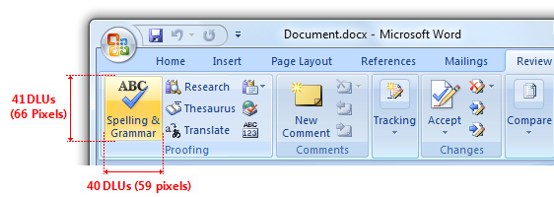
User Experience Considerations
General guidelines
  Big targets
  Whitespace
  Avoid hover
  See UX guidelines
Be aware of hardware
  Form factor
  Avoid on-hover UI
  Edges, jitter, etc.
Gesture guidelines
  Use common gestures
  Gestures need to be intuitive and natural
  Moving away from shortcut style gestures to manipulations

Slide 43
Call To Action
Decide which application scenarios make sense for touch
Decide which tier of investment
is appropriate
Check your current applications
Add:
  Gesture
  Or manipulation
  Or inertia
Build something amazing!

Slide 44

© 2007 Microsoft Corporation. All rights reserved. Microsoft, Windows, Windows Vista and other product names are or may be registered trademarks and/or trademarks in the U.S. and/or other countries.
The information herein is for informational purposes only and represents the current view of Microsoft Corporation as of the date of this presentation. Because Microsoft must respond to changing market conditions, it should not be interpreted to be a commitment on the part of Microsoft, and Microsoft cannot guarantee the accuracy of any information provided after the date of this presentation.
MICROSOFT MAKES NO WARRANTIES, EXPRESS, IMPLIED OR STATUTORY, AS TO THE INFORMATION IN THIS PRESENTATION.

