Slide 1
Windows 7 Training

Slide 2
Energy-Efficient Applications
Microsoft® Corporation

Slide 3
Agenda
Why is power consumption important?
Hardware and software power savings techniques:
Coalescing timers
Power state notifications
Background activities
Interfering power transitions
Power availability requests
Power policies
Power efficiency diagnostics

Slide 4
Importance of Power Consumption
Core 2 Extreme QX6700
Power consumption (W)
80386SX
Courtesy Jim Larus, Microsoft Research

Slide 6
Importance of Power Consumption
Computer energy consumption increasing exponentially over time
Software has a critical impact on battery life
Use advanced hardware power optimization
Key goals:
“All day” battery life
Reducing costs of energy consumption
Regulatory and environmental compliance

Slide 7
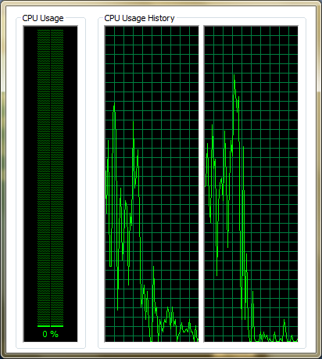
CPU Power Savings
Optimize performance
Minimize CPU utilization when idle
Idle is the most common user scenario
Defer work to AC power state
Power Consumption (W)
Processor Utilization

Slide 8
CPU Power Savings Polling
Avoid polling – use events
Do not poll for power state
RegisterPowerSettingNotification
Do not poll more often than once a second
Use coalescing timers when polling
SetWaitableTimerEx with delay tolerance
Timer tick
15.6 ms
Windows Vista®
Periodic timer events
Windows® 7

Slide 9
Timer Coalescing API
SetWaitableTimerEx(
__in HANDLE hTimer,
__in const LARGE_INTEGER *lpDueTime,
__in LONG lPeriod,
__in_opt PTIMERAPCROUTINE pfnCompletionRoutine,
__in_opt LPVOID lpArgToCompletionRoutine,
__in_opt PREASON_CONTEXT WakeContext,
__in ULONG TolerableDelay
);

Slide 10
Coalescing Timer Native Code
HANDLE hTimer =
CreateWaitableTimerEx(...);
SetWaitableTimerEx(
hTimer,
...,
&reasonContext,
tolerableDelay);

Slide 11
CPU Power Savings Multimedia Timers
Multimedia timers can change Windows scheduler timer resolution
Default on SMP: 15.6ms
Increasing timer resolution increases power consumption
Up to 20% impact on battery life
Frequent interrupt
Prevents CPU from entering low-power states
Enable the high-resolution timer on demand
Aim for 10ms, not less

Slide 12
Windows Vista Bridge Sample
Managed class library to ease .NET Framework access to Windows Vista features
UAC, power management, restart and recovery, network awareness, Aero glass, and more
It is a sample library not a full product
Open source with no support
Use at your own risk

Slide 13
The Windows Bridge V1.3 Support Power Aware Application
Enables access to Windows Vista and Windows 7 library API from managed code
Contains the PowerManager class that wraps the Windows power APIs
Power aware, power sources
Battery status
Power notifications
It is a sample library not a full product
Open source with no support
Use at your own risk

Slide 14
Coalescing Timer Sample Managed Wrapper
CoalescingTimer t =
new CoalescingTimer("Name");
t.Tick += delegate { ... };
//Due time, period, reason, delay
t.Set(0, 1000, "Reason", 50);

Slide 15
Power Setting Notification Native Code
RegisterPowerSettingNotification(
hwnd,
powerSettingGuid, //see SDK
DEVICE_NOTIFY_WINDOW_HANDLE);
/* Handle WM_POWERBROADCAST
with PBT_POWERSETTINGCHANGE. */

Slide 16
Power Setting Notification Managed Code (Windows Vista Bridge Library)
PowerManager.PowerSourceChanged +=
delegate {
//Use PowerManager.PowerSource;
};
/* And other PowerManager methods:
PowerManager.IsBatteryPresent
PowerManager.BatteryLifePercent
etc. */

Slide 17
Power Setting Notification
demo
…and doing something in response

Slide 18
CPU Power Savings Animations
Animations consume CPU and GPU power
Avoid animations when idle
Avoid tray icon animations when idle
Disable animations when a power saving plan is active or the system is on battery power

Slide 19
Hard Drive Power Savings
Rotational hard disk drives consume ~8% power
Avoid periodic disk activity when idle
Avoid registry activity when idle
Registry activity ➔ disk activity

Slide 20
Background Activities
Defer work to background activities
Background activities (that is, tasks and services) can be scheduled based on environment
Start task only on AC power
Stop task if switched to battery power
Start service when needed on a specific trigger
See “Background Services” presentation

Slide 21
Interfering Power Transitions
Sleep must not be blocked if initiated by the user
Stop any hardware actions (network transfer, file copy, and so on)
When resuming:
Assume environment changes (for example, network)
All applications are resuming at the same time (expect resource bottlenecks)
Roughly the same guidelines apply to system startup and shutdown
Including hibernate

Slide 22
Power Availability Requests
Applications can delay automatic sleep
For example, when downloading a file, recording TV, burning a disc, and so on
SetThreadExecutionState (old API)
Replaced in Windows 7 by the detailed availability request API
PowerCreateRequest, PowerSetRequest, PowerClearRequest
Powercfg.exe /requests

Slide 23
Power Availability Request Native Code
HANDLE hRequest =
PowerCreateRequest(&reason);
PowerSetRequest(
hRequest,
POWER_REQUEST_TYPE);

Slide 24
Power Availability Request Sample Managed Wrapper
PowerAvailability.CreateRequest(
"My Reason",
PowerRequestType.DisplayRequired);

Slide 25
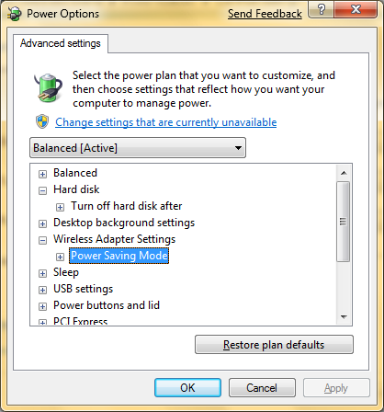
Windows Power Policies
Wireless adapter
Hard disk
PCI link state
Processor power state
Display dim and off

Slide 26
Power Efficiency Diagnostics
Windows performance counters
Windows Performance Toolkit (XPerf)
See “Instrumentation and Performance” presentation
New in Windows 7:
Powercfg.exe /energy
Automatically executed when idle and reported to Microsoft Customer Experience Improvement Program

Slide 27
Energy Efficiency Report
demo
…analyzing power consumption

Slide 28
Power
Q & A
…everything you were afraid to ask

Slide 29
Summary
Why is power consumption important?
Hardware and software power savings
Coalescing timers
Power state notifications
Background activities
Interfering power transitions
Power availability requests
Power policies
Power efficiency diagnostics
Be a good citizen… become power aware!

Slide 30
Additional Resources
Application Power Management Best Practices for Windows Vista
http://www.microsoft.com/whdc/system/pnppwr/powermgmt/PM_apps.mspx
Power Event Monitoring Tool Sample Application
Sample Microsoft Visual Studio® project for registering and receiving power notifications
http://www.microsoft.com/whdc/system/pnppwr/powermgmt/PM-apps_samp.mspx
Make Your WPF Apps Power-Aware
http://msdn.microsoft.com/en-us/magazine/cc163386.aspx
“Power To The People”
C# interoperability for most Windows Vista and later power APIs
http://www.code-magazine.com/articleprint.aspx?quickid=0512102&printmode=true
Windows Performance ToolKit (XPerf)
http://msdn.microsoft.com/en-us/library/cc305187.aspx
PwrTest (power management test tool)
Available in Windows Driver Kit (WDK)
http://www.microsoft.com/whdc/DevTools/WDK/WDKpkg.mspx

Slide 31
© 2007 Microsoft Corporation. All rights reserved. Microsoft, Windows, Windows Vista and other product names are or may be registered trademarks and/or trademarks in the U.S. and/or other countries.
The information herein is for informational purposes only and represents the current view of Microsoft Corporation as of the date of this presentation. Because Microsoft must respond to changing market conditions, it should not be interpreted to be a commitment on the part of Microsoft, and Microsoft cannot guarantee the accuracy of any information provided after the date of this presentation. MICROSOFT MAKES NO WARRANTIES, EXPRESS, IMPLIED OR STATUTORY, AS TO THE INFORMATION IN THIS PRESENTATION.

