Slide 1
Windows 7 Training

Slide 2
Instrumentation and Performance
Name
Title
Microsoft Corporation

Slide 3
Setting Expectations Source: http://tinyurl.com/e7-on-perf
Boot-very very fast in all applications (open-load applications) especially so many simultaneously!!!!!
I want to be able to run windows 7 extremely fast and still look good graphically on a asus aspire one netbook with these specs-1.5 ghz intel atom processor (single core) 1gb of ram
I do keep my fingers crossed for Windows 7 to be dramatically better in its performance than Windows Vista.

Slide 4
Agenda
Performance Counters
Event Tracing for Windows (ETW) & Event Log
Windows Management Instrumentation
Windows Performance Toolkit
Windows Troubleshooting Platform

Slide 5
Motivation
What is my system doing?
CPU, I/O, Memory
Why does my application perform badly?
On the client machine
On some hardware
I need to know what is wrong (where) in my code that make the system acts badly
How should I report an application state
To me, for debugging
For the Sys Admin for management

Slide 6
Windows Instrumentation
Key Features
High-performance, low overhead, highly scalable
Native and Managed APIs
Dynamic enablement of data collection
Multiple data collection options
 | Performance Counters | Events
Example Usages | Expose processing rates Measure performance | General notifications Errors and warnings Trace actions for debugging
Data Types | Strictly Numerical | No restriction
Data Consumption | Polled in real-time Written to a log file | Delivered in real-time Written to a log file Buffered in memory
Applications can make use of both Performance Counters and Events

Slide 7
Windows Performance Counters
Always-present, always-on instrumentation infrastructure
Numeric information grouped into categories, counters and instances
Access:
Programmatically (native and managed)
Through script languages
Using the Performance Monitor tool (perfmon)
Examples

Slide 8
Performance Counters
demo
PerfMon
Defining logs

Slide 9
Performance Counter Improvements In Windows 7
New Version 2.0 Kernel Mode APIs
Declaratively defined in XML
Leverages Version 2.0 infrastructure from Vista
Fundamental Quality Investments
Enhanced performance, scalability, and robustness
Several new system counters exposing Windows internals
Improved design-time validation
Scriptable Consumption using PowerShell
Consume live counters (get-counter)
Read and write counter log files (import-counter/export-counter)

Slide 10
Exposing Performance Counters
Native:
Create a manifest
Use the CTRPP preprocessing tool
PerfAutoInitialize
PerfCreateInstance
PerfSet*Counter*Value
Managed: System.Diagnostics namespace
PerformanceCounterCategory class
CounterCreationDataCollection class
PerformanceCounter class

Slide 11
Exposing Performance Counters Managed Code
var counters = new CounterCreationDataCollection ();
counters.Add(new CounterCreationData(...));
PerformanceCounterCategory.Create(..., counters);
PC instance = new PerformanceCounter(...);
instance.RawValue = 128;

Slide 12
Performance Logs and Alerts
Performance counters can be logged in various formats
Logs can be exported as templates
Performance information can be queried from remote systems
Alerts can be generated when thresholds are breached

Slide 13
Performance Counters
demo
…exporting and viewing custom performance counters

Slide 14
ETW/Event Log Event Tracing for Windows
Always-present, selectively-on logging infrastructure
Custom levels and enabling keywords
Information defined by event templates
Access:
Programmatically (native and managed)
Script languages (PowerShell)
Command Line tools (tracerpt)
Event Viewer

Slide 15
Windows Event Overview
Event Audience | Developer; IT Professional | System Administrator
Technology | ETW | Event Log
Event Control | Manual | Always On
Event Rate | High (10^4 / sec) | Medium (10^2 - 10^4 / sec)
Features | Declaratively defined in manifests Programmatic Consumption Discoverability Localizable Strings Flexible Data Model | Same Features of ETW plus: Remote Collection Data Query Support Admin Focused Tools Centralized event logs Reduced logging rate
Common API Set and Development Model

Slide 16
Event Architecture
Providers define events and register with the ETW/Event Log infrastructure
Manifest files define events that can be generated, log levels, templates etc.
Controllers start and stop tracing sessions
Consumers subscribe to receive events in real-time or from an existing log file
Providers write events to the log if it is enabled
Providers are automatically enabled to the Event Log if they log to channels.

Slide 17
Event Descriptor
typedef struct _EVENT_DESCRIPTOR {
USHORT Id;
UCHAR Version;
UCHAR Channel;
UCHAR Level;
UCHAR Opcode;
USHORT Task;
ULONGLONG Keyword;
} EVENT_DESCRIPTOR, *PEVENT_DESCRIPTOR;

Slide 18
Event Anatomy
Id - uniquely identify an event in a provider
Event Id + Provider Id (Guid) => Manifest Id
Version – May changed in future releases
Channel - grouping of events
Level - enable filtering based on the severity
Keywords - indicate sub-components in a provider
Opcode - the specific operation being performed
Task - specifies a common logical component or task being instrumented

Slide 19
Event Anatomy
For example, the Windows kernel provider groups all file I/O operation events into a "FileIO" task. Opcode indicates what the operation was, such as Create, Open, Read, and Write

Slide 20
Channels
Defines a group of events for a target audience
A channel belongs to one of the four types:
Admin
Target the Admin
Goes to event log
Operational
Targeted at high-level monitoring tools
Offer more detailed context
more frequent than admin channel events
Goes to event log

Slide 21
Channels
Analytic
Targeted at expert-level support professionals
Detailed diagnosis and troubleshooting tools
Debug
Used for debug messages
Contains events that are meant to be consumed by developers.
Analytic and debug channel events are not enabled by default

Slide 22
Event Manifest
The event descriptors and layouts are specified in the event manifest
Developers write the event manifest when instrumentation is designed
An event manifest is written in XML
user-defined channels, tasks, opcodes, levels, and keywords are specified in appropriate XML tags

Slide 23
Event Template
The layout of an event should be specified through a <Template> tag
A template describes user-specified context data that each event includes
The template can define the layout, which may contain individual data fields
such as integers and strings, or complex data structures such as an array of structs

Slide 24
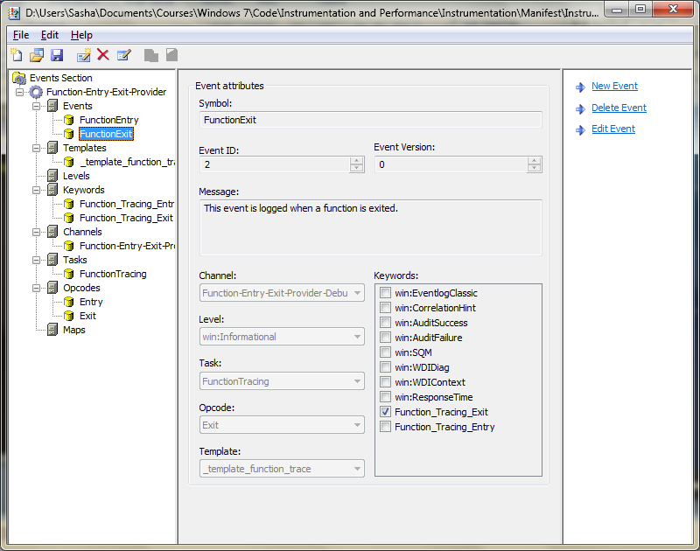
Manifest Generator - ecmangen

Slide 25
Instrumentation Design Workflow Five Steps
3
Generate
Code
.rc
1
Design
5
Build
New
Provider
Create
Instrumentation
Manifest
(ECMangen)
XML
Manifest
CTRPP / MC
preprocessors
Design
.c
Build
2
Instrumentation
Definition
.h
Instrument
provider APIs
New
provider
code
4
Instrument

Slide 26
Providing Events Generated Native Code
Status = EventRegisterMyProvider();
…
EventWriteMyEvent(42, 3.14, “My String”);
…
EventUnregisterMyProvider();

Slide 27
Providing Events Generated Managed Code
MyProvider simplePrvdr =
new MyProvider();
…
simplePrvdr.EventWriteMyEvent(
42, 3.14, “My String”);
…

Slide 28
ETW/Event Log
demo
…providing and consuming events

Slide 29
ETW/Event Log Improvements In Windows 7
Fundamental Quality Investments
Enhanced performance, scalability, and robustness
Several new Windows events and event providers
Event Development
Improved design-time validation
Automatically generate code from XML
Event Consumption
Scriptable consumption using PowerShell (get-WinEvent)
Discover and read ETW or Event Log events locally or remotely
Portable event log file decoding
Improved data formatting

Slide 30
Instrumentation Design Considerations
Design for the appropriate audience
Provide meaningful event messages and counter descriptions
Provide actionable events and counters for System Administrators and IT Professionals
Use recommended interfaces
Performance Counters Version 2.0
Managed – System.Diagnostics.PerformanceData
User Mode – PerfSet*(), PerfIncrement*(), etc.
Kernel Mode – PcwRegister(), PcwCreateInstance(), etc.
Manifest-based ETW and Event Log APIs
Managed – System.Diagnostics.Eventing
User Mode – EventWrite(), etc.
Kernel Mode – EtwWrite(), etc.
Design your application’s events and counters with a goal in mind

Slide 31
WMI Windows Management Instrumentation
Windows Management Instrumentation
Not new
Lots of improvement on NT v6.x
IP V6
ETW Support
Security Enhancement
Hyper-threading and multi-core processors
…
Query properties
Execute methods

Slide 32
WMI Windows Management Instrumentation
Always-present, always-on instrumentation infrastructure
Rich information grouped into namespaces, classes, properties, methods and events
Access:
Programmatically (native and managed)
Through script languages
Using the WMI Console
Examples

Slide 33
WMI Architecture
WMI itself is the Winmgmt service which communicates through DCOM/135
It is possible to route WMI through HTTP/80
Providers expose data properties, methods and event information
Consumers register to events, read/write properties and invoke methods

Slide 34
Writing a WMI Consumer VBScript Code
Set WMI = GetObject("winmgmts:“...)
Set products = WMI.ExecQuery _
("Select * from
Win32_WindowsProductActivation")
For Each product in products
product.ActivateOnline()
Next

Slide 35
Writing a WMI Consumer Managed Code
ManagementObjectSearcher s =
new ManagementObjectSearcher(
...,"SELECT * FROM Win32_Share");
foreach (var share in s.Get()) {
Console.WriteLine(share.
GetPropertyValue("Path0"));
}

Slide 36
Writing a WMI Provider http://tinyurl.com/net-WMI
[InstrumentationClass(
InstrumentationType.Event)]
public class
CpuTemperatureTooHighEvent {
public float Temperature { ... }
public static void Publish(float f) {
Instrumentation.Fire(
new CpuTemperatureTooHighEvent(f));
} }

Slide 37
Consuming WMI
demo
…integrating system administration

Slide 38
Windows Performance Toolkit
xperf.exe: Command-line tool for ETW capturing and processing
xperfview.exe: Visual trace analysis tool
xbootmgr.exe: On/off transition state capture tool
Works on Windows Vista SP1, Windows Server 2008 and Windows 7

Slide 39
Xperf Scenarios
Profile applications or the system itself (sampling profiler mode)
Capture ETW data for later analysis
Determine whether an application is I/O- or CPU-bound
…and many others!

Slide 40
Capturing a Trace
Turn tracing on: xperf -on <PROVIDER>
Perform activities
Capture a log: xperf -d <LOG_FILE_NAME>
Analyze it: xperf <LOG_FILE_NAME>
xperf -on Base
xperf -d result.etl
xperfview result.etl

Slide 41
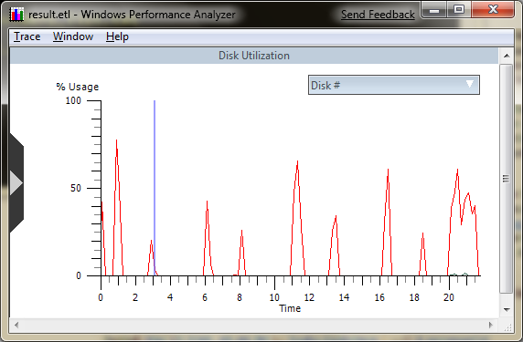
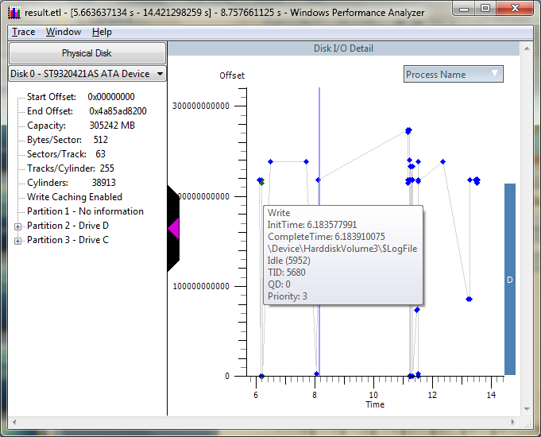
Xperf: Disk Utilization

Slide 42
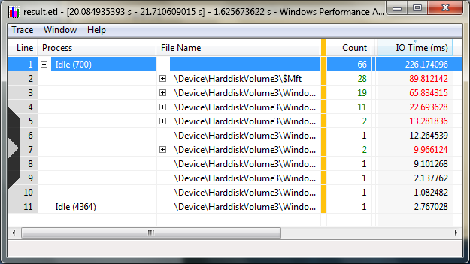
Xperf: Hard Page Faults

Slide 43
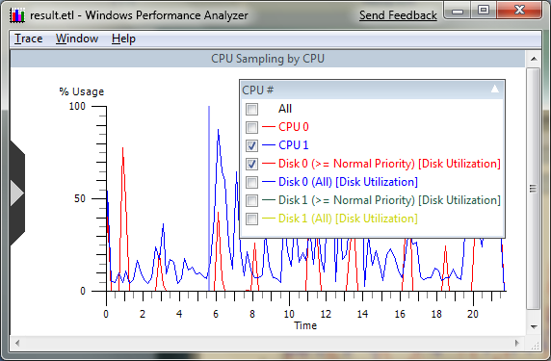
Xperf: Overlay Graph

Slide 44
Xperf
demo
…looking at system activity

Slide 45
Windows Troubleshooting
Automating troubleshooting
Bring the system to the supported and working configuration
Examples:
Troubleshoot application compatibility
Troubleshoot audio playback
Troubleshoot power consumption

Slide 46
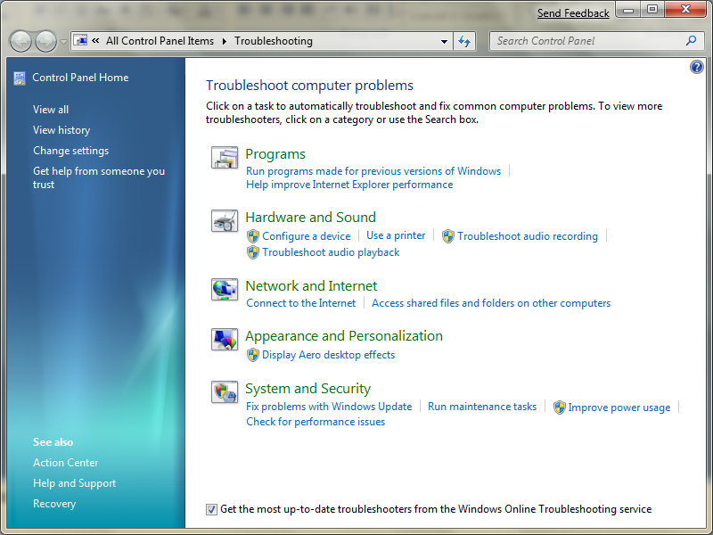
Troubleshooting Control Panel

Slide 47
Troubleshooting
demo
…detecting configuration problems

Slide 48
Troubleshooting Pack Anatomy
Identification Metadata
Name and description
List of configuration issues
Security signature
Checks current configuration with expected configuration
Sets the current configuration to what is expected
Verifies that current configuration is now what is expected
Contains localized display strings in MUI format
Detection Scripts
Trouble-shooting Pack
Resolution Scripts
Verification Scripts
Localized Resources

Slide 49
Troubleshooting Components
Troubleshooting Pack:
Implemented in PowerShell V2
Uses a standard wizard interface
Signed by a certificate
Deployed as .cab files
Can run remotely, can run unattended
Troubleshooting Platform:
Executes troubleshooting packs
Generates reports for analysis
Windows Online Troubleshooting Service

Slide 50
Instrumentation and Performance
Q&A
…everything you were afraid to ask

Slide 51
Summary
ETW for debugging
High volume information
Event Log and Performance Counters for administration
Admin/IT Pro consumption
Remote Consumption
Windows Management Instrumentation
For management applications
Support notification, methods & properties
Don’t forget Windows Performance Toolkit

Slide 52
Performance Counters Performance Toolkit
hands-on lab
…instrumenting and analyzing

Slide 53
© 2007 Microsoft Corporation. All rights reserved. Microsoft, Windows, Windows Vista and other product names are or may be registered trademarks and/or trademarks in the U.S. and/or other countries.
The information herein is for informational purposes only and represents the current view of Microsoft Corporation as of the date of this presentation. Because Microsoft must respond to changing market conditions, it should not be interpreted to be a commitment on the part of Microsoft, and Microsoft cannot guarantee the accuracy of any information provided after the date of this presentation. MICROSOFT MAKES NO WARRANTIES, EXPRESS, IMPLIED OR STATUTORY, AS TO THE INFORMATION IN THIS PRESENTATION.

