Slide 1
Windows Application Compatibility
Vineet Sarda
Application Development Consultant
Vineet.Sarda@microsoft.com

Slide 2
Windows 7 Builds on Windows Vista Deployment, Testing, and Pilots Today Will Continue to Pay Off
Windows 7
Few Changes: Most software that runs on Windows Vista will run on Windows 7 - exceptions will be low level code (AV, Firewall, Imaging, etc).
Hardware that runs Windows Vista well will run Windows 7 well.
Few Changes: Focus on quality and reliability improvements
Deep Changes: New models for security, drivers, deployment, and networking
Notes:
KEY TAKEAWAYS:
We are not going to cause the same level of pain as we did with Windows Vista.
The changes we made in WV caused problems, but the benefits are here now.
The path to Windows 7 should be as smooth as the shift from RTM to SP1.
In Windows 7 we are building on the advances we made in Windows Vista to help address emerging trends and technologies and meet the needs we’ve heard from our customers.
The most important thing we’ve learned is that there is no one-size-fits all solution that’s best for every business. If anything, businesses are becoming more diverse. Some have a large number of mobile workers, some have workers distributed in branch offices around the world.
Windows 7 Enterprise, part of the Microsoft Optimized Desktop, gives you the flexibility to support the diverse needs of your unique business by enabling users to Access Information Anywhere, providing greater levels of Security & Control, and Streamlining PC Management.
We will be building these new capabilities without making significant architectural changes to the Windows platform. We want to make this clear so businesses can have confidence that investments they make to optimize their infrastructure with Windows Vista and MDOP today will put them in the best position to deploy Windows 7 when it‘s available.
Windows 7 will be built on the Windows Vista foundation and will inherit the quality improvements we’ve made in Windows Vista Service Pack 1 and Windows Server 2008.
Compatibility with Windows Vista software, hardware and tools is an important goal of this release. We are not able to make specific statement at this time about system requirements or compatibility levels—but we know that we have engaged with the ecosystem much earlier and are not making the broad types of changes to the kernel, driver, or graphics subsystems that we made in Windows Vista.
In building Windows Vista we made some significant changes to the platform that had an impact on compatibility. Those changes were important and had a measurable improvement on security. Windows Vista is the most secure client version of Windows to date and experienced fewer than half the number of security vulnerabilities that Windows XP experienced in its first year, and fewer than one-fifth the number of security vulnerabilities as the nearest competitive operating system on the market.
Windows 7 also benefits from these important changes, since we are not undoing the changes we made in Windows Vista that resulted in significant security improvements. This also means that customers still using Windows XP when Windows 7 comes out should expect a similar level of compatibility between Windows XP and Windows 7 as there is between Windows XP and Windows Vista.
However, the upgrade from Windows Vista to Windows 7 should be easier, given compatibility between these two products. We recommend customers upgrade to Windows Vista now, then move to Windows 7 because the investments required to test and remediate applications, update deployment tools and processes, upgrade hardware will be similar—and you get the benefits of a more secure, modern operating system for a longer time.
In Windows 7 we are not making significant changes to the componentization, setup model, or kernel. There will of course be limited changes made to fix bugs and additional features in those areas, but these are not the places we are making significant investments in this release.
The client release of Windows 7 will be available in 32 & 64-bit versions.

Slide 3
Windows UAC Overview
All users run as Standard User by default
Filtered token created during logon
Only specially marked apps get the unfiltered token
Explicit consent required for elevation
Predictable shell elevation paths
High application compatibility
Data redirection
Enabling legacy apps to run as standard user
Installer Detection

Slide 4
UAC Architecture
Standard User Rights
Administrative Rights
Admin logon
Abby
Admin Token
“Standard User” Token

Slide 5
UAC Architecture
Standard User Rights
Administrative Rights
Standard User Mode
Standard User Privilege
Change Time Zone
Run IT Approved Applications
Install Fonts
Install Printers
Run MSN Messenger
Etc.
Abby
User Process

Slide 6
UAC Architecture
Standard User Rights
Administrative Rights
Admin Privileges
Standard User Privilege
Admin Privilege
Change Time
Change Time Zone
Run IT Approved Applications
Install Fonts
Install Printers
Run MSN Messenger
Etc.
Admin Process
Admin Privilege
Configure IIS
Admin Process
Abby
Install Application
Admin Privilege
User Process
Admin Process

Slide 7
The Split Token
Run with fewer rights most of the time
Conveniently elevate when you need rights
Applies to interactive logons only

Slide 8
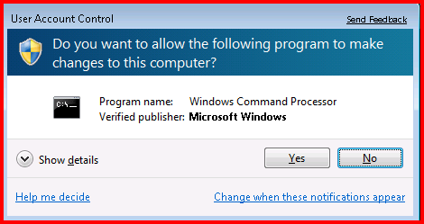
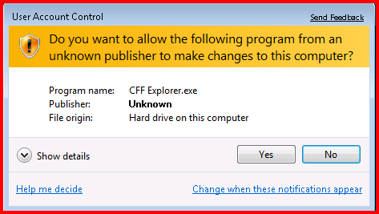
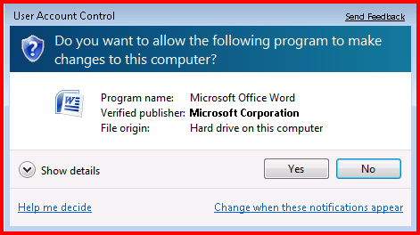
Consent UI
OS Application
Unsigned Application
Signed Application
Notes:
2/18/2009 7:03 PM
8
©2005 Microsoft Corporation. All rights reserved.
This presentation is for informational purposes only. Microsoft makes no warranties, express or implied, in this summary.

Slide 9
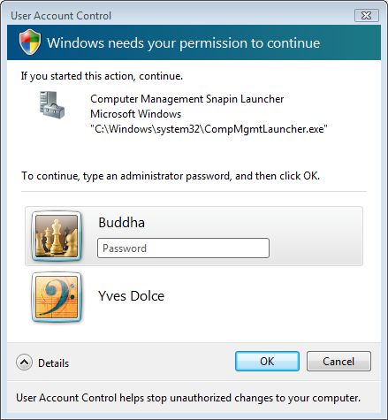
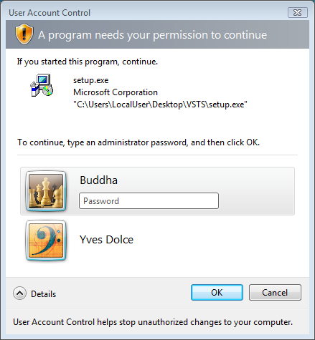
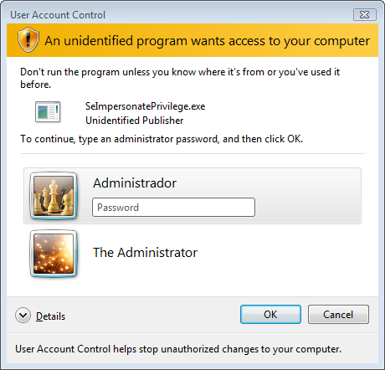
Credential UI
Notes:
2/18/2009 7:03 PM
9
©2005 Microsoft Corporation. All rights reserved.
This presentation is for informational purposes only. Microsoft makes no warranties, express or implied, in this summary.

Slide 10
UAC Split Tokens
Demo

Slide 11
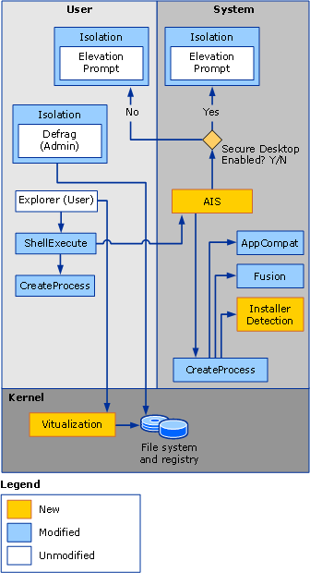
UAC Architecture
Elevation happens per process
1 process = 1 elevation level
Immutable for life of process
Process creation API choice!

Slide 12
Designing for UAC
1st Choice: Make application run as Standard User only
2nd Choice: Clearly identify Administrative tasks
Ensure Standard users can be fully productive
Identify tasks that need elevation with a “shield”

Slide 13
UX: The Shield
Attached to controls to indicate that elevation is required to use their associated feature
Has only one state (i.e. no hover, disabled etc.)
Does not remember elevated state
Not an unlock operation
Can be programmatically set:
HICON shieldIcon = LoadIcon(NULL, IDI_SHIELD)
SendMessage(button, BCM_SETSHIELD, 0, TRUE) or using the macro in Commctrl.h:
Button_SetElevationRequiredState(commandLink, TRUE)

Slide 14
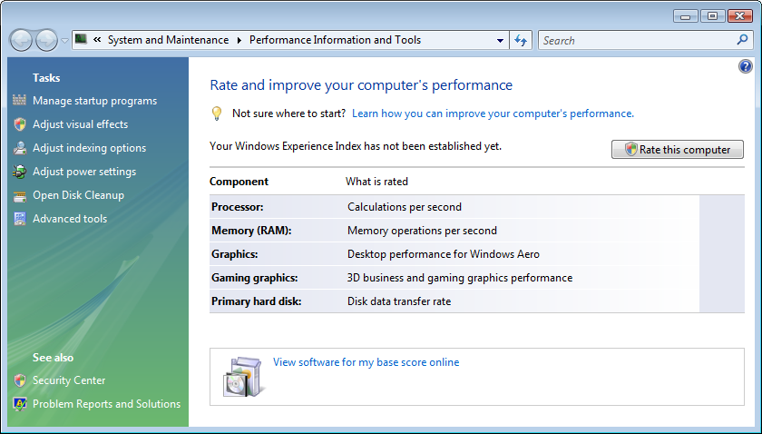
Security Shield UI Examples

Slide 15
Separation of Admin Code
Cannot elevate a running process
Three Design Patterns
Creation of an Administrator COM object to perform elevated task.
COM Elevation Moniker
Side by Side Processes
Shared memory
RPC
Service Broker Model (no consent dialog)
RPC, named pipes, etc

Slide 16
Application Manifests
Vista-aware applications embed an XML manifest
Manifest contains a RequestedExecutionLevel:
asInvoker | Launch with the same token as the parent process
highestAvailable | Launch with the highest token this user possesses
requireAdministrator | Highest token of the User provided User is a member of Administrators group
Notes:
16

Slide 17
UAC Manifest
MyAdminApp.Exe.Manifest
<?xml version="1.0" encoding="UTF-8" standalone="yes"?>
<assembly xmlns="urn:schemas-microsoft-com:asm.v1" manifestVersion="1.0">
<assemblyIdentity version="1.0.0.0" processorArchitecture="X86" name="MyAdminApp" type="win32"/>
<!-- Identify the application security requirements. -->
<trustInfo xmlns="urn:schemas-microsoft-com:asm.v3">
<security>
<requestedPrivileges>
<requestedExecutionLevel level="requireAdministrator"/>
</requestedPrivileges>
</security>
</trustInfo>
</assembly>
Notes:
17

Slide 18
UAC Manifest Guidance
Windows Vista: internal > external
You didn’t write code -> don’t manifest
Removes compatibility features / shims
mt.exe
Visual Studio 2008 native support

Slide 19
UAC Mitigations for legacy apps
Pre Vista aware applications (legacy) will get:
Installer Detection
Data Redirection

Slide 20
Installer Detection
Without this, almost all custom (non-MSI) legacy installations would fail
Heuristics: look for Setup, Install, Update, etc.
Looks in binary name and resources
Auto adds shield icon when detected
Elevated when launched

Slide 21
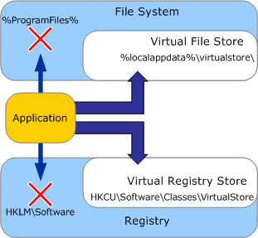
Data Redirection
This is a intended for existing legacy applications and will be removed in a future OS version
32-bit legacy interactive applications that write to administrator locations
HKLM\Software;
%SystemDrive%\Program Files
%WinDir%\System32
Redirected to:
HKCU\Software\Classes\VirtualStore
%LocalAppData%\VirtualStore\
Redirection removes need for elevation
Writes to HKLM go to HKCU redirected store
Writes to system directories redirected to per-user store
When running 32-bit applications on x64, WOW64…

Slide 22
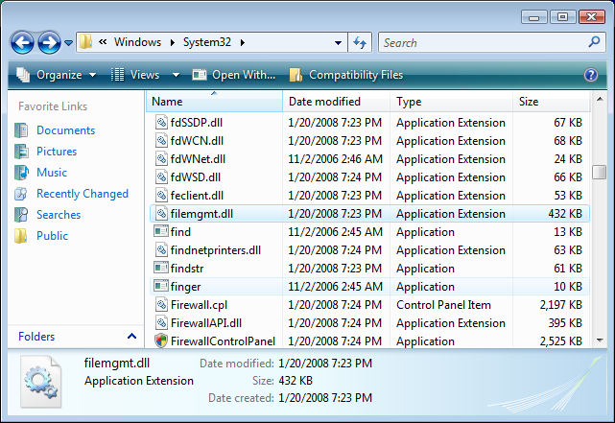
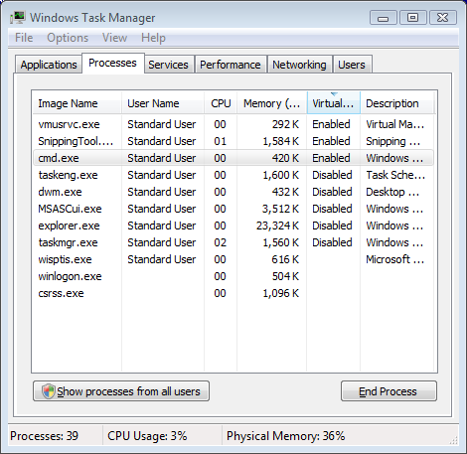
Data Redirection and explorer

Slide 23
Mandatory Integrity Control (MIC)
Traditional NT security revolves around process token
Windows Vista enhances this with MIC:
Each process gets a MIC level
All resources get a MIC level
There are four levels:
Integrity level SID | Name
S-1-16-4096 | Mandatory Label\Low Mandatory Le
S-1-16-8192 | Mandatory Label\Medium Mandatory Level (default)
S-1-16-12288 | Mandatory Label\High Mandatory Level
S-1-16-16384 | Mandatory Label\System Mandatory Level

Slide 24
Process Isolation with MIC: Protecting Administrative Applications
Administrative and standard user applications share the same desktop
Primary threats
Cross-process Window messages
DLL injection and create remote thread
Process Isolation mechanisms
Integrity level for processes
UI Privilege Isolation
“Lower” cannot interfere with “Higher”
Admin App
MIC = High
User Process
MIC = Medium

Slide 25
MIC and Resources
MIC levels apply to:
Processes
COM components
Services
Files
Registry keys
View MIC level on files and other resources using AccessChk.exe from SysInternal
IE currently only application that has a MIC level of Low
All IE resources need low as well
Resources medium by default in Vista

Slide 26
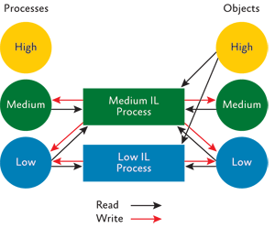
MIC and Securable Objects

Slide 27
Internet Explorer Protected Mode

Slide 28
IE Protected Mode
Internet explorer runs with low permissions (low MIC)
IE cannot even modify user files, registry keys
File/registry writes are redirected, visible from IE only. Different than UAC virtualization
Windows Messaging blocked to non-low IL
Issues
Controls that share data with external processes fail
New prompts requesting user permission interaction may impact some apps
Mitigations
Add the site to the trusted sites list (turns off protected mode)
Surprising twists
Creating an OOP COM component from IE fails

Slide 29
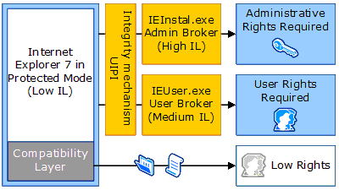
IE – Protected Mode
Resource:
“Understanding and Working in Protected Mode Internet Explorer”
http://msdn.microsoft.com/library/default.asp?url=/library/en-us/ietechcol/dnwebgen/protectedmode.asp
Notes:
UIPI: User Interface Privilege Isolation
2/18/2009 7:25 PM
29
© 2005 Microsoft Corporation. All rights reserved.
This presentation is for informational purposes only. Microsoft makes no warranties, express or implied, in this summary.

Slide 30
Compatibility Features
In-proc add-ons (ActiveX controls, toolbars, etc)
Same privileges as Protected Mode
File system writes get re-routed to the TIF via a compatibility layer
Call “Save As” API (IESaveFile) to save files outside of the TIF
Out-of-proc add-ons (Doc object servers, etc)
Same restrictions as Protected Mode by default
Elevated privileges possible
Internet and Intranet sites run in Protected Mode
Administrators can change this through Group Policy
Trusted Sites/Local Machine zone don’t run in Protected Mode
Navigation between zones in Protected Mode and zones outside of Protected Mode results in the creation of a new IE process
Notes:
We’re adding major changes to IE’s platform to be backward compatible
The Compat layer allows most in-proc add-ons work in Protected Mode flawlessly by continuing to write settings. Only add-ons that need to place user data in a known location for the user or another app to see will need to call the new SaveAs API.
Although Trusted Sites run in UAC, they should never be used as a workaround since these sites become attack vectors and run with more permissions than Internet sites.
The Trusted Sites Zone will necessarily result in being an attack vector since these sites run with more privileges. Given a cross domain issue due to an IE URL Parsing or Navigation error, an attacker can get their malicious page to run in the Trusted Sites Zone. For example, an attacker would be able to bypass Protected Mode using this technique if they 1) know users have www.fooCA.com on their Trusted Sites list and 2) can fool IE into thinking that their crafted URL is fooCA.com. There are other real-world examples of this on the IE blog here: http://blogs.msdn.com/ie/archive/2005/01/26/361228.aspx
BTW: We’re upgrading the Trusted Sites Zone’s security template level to Medium from Medium-Low in Vista so users get prompted before AX installation
If a window at the right permissions level exists it will be used for navigating between Internet and Intranet

Slide 31
In-proc: Compatibility Layer
Redirects file/registry writes to a Low Integrity location
HKCU\Software\Microsoft\Internet Explorer\InternetRegistry
%LocalAppData%\Microsoft\Windows\ Temporary Internet Files\Virtualized
Virtualized path is the full pathname added to the virtualized directory:
Write Attempt | Actual Virtualized Write Location
HKCU\Software\FooBar\ | HKCU\Software\Microsoft\Internet Explorer\InternetRegistry\ Software\FooBar
C:\Users\BobSmith\FooBar | C:\Users\BobSmith\AppData\Local\ Microsoft\Windows\Temporary Internet Files\Virtualized\ C\Users\BobSmith\FooBar
Notes:
Redirect writes to restricted sections of the file system and registry to a holding zone like the Temporary Internet Files folder where untrusted files or values can’t corrupt user files
If we used UAC virtualization, we’d have to make sure that Protected Mode and UAC virtualization were isolated
Protected Mode can’t write to UAC virtual store since this is elevation

Slide 32
Saving to Low IL Locations
Is IE running in Protected Mode?
IEIsProtectedModeProcess() http://msdn.microsoft.com/en-us/library/ms537316.aspx
Get the Temporary Internet Files location:
IEGetWriteableFolderPath() http://msdn.microsoft.com/en-us/library/ms537314.aspx
SHGetKnownFolderPath(FOLDERID_LocalAppDataLow, …) http://msdn.microsoft.com/en-us/library/bb762188(VS.85).aspx
Get the Low Integrity Level registry key:
IEGetWriteableHKCU() http://msdn.microsoft.com/en-us/library/ms537315.aspx
Notes:
From: http://msdn2.microsoft.com/en-us/library/Bb250462(d=printer).aspx
Finding Low Integrity Write Locations
In Windows Vista, securable objects automatically inherit the lower integrity level between the process that created them and their container. As a result, files or registry keys have a low integrity when created in Protected Mode. This means that a low integrity process can obtain write access to the objects it creates. However, a low integrity process cannot gain write access to medium or high integrity folders or files in the user's profile.
Before writing to a low integrity location, extensions can determine if Internet Explorer is running in Protected Mode by calling the IEIsProtectedModeProcess [ http://msdn.microsoft.com/library/default.asp?url=/workshop/security/protmode/reference/functions/ieisprotectedmodeprocess.asp ] function. When in Protected Mode, extensions can write files to a folder below the user's UserProfile folder, typically %userprofile%\AppData\LocalLow. Use the SHGetKnownFolderPath function with the FOLDERID_LocalAppDataLow flag to obtain the expanded folder name.
SHGetKnownFolderPath(FOLDERID_LocalAppDataLow, 0, NULL, szPath, ARRAYSIZE(szPath)); Note Protected Mode modifies IE's environment variables. As a result, the GetTempPath() function returns %Temp%\Low when called while Protected Mode is active.
Low integrity processes can create and write to low integrity subkeys of the registry, such as HKEY_CURRENT_USER\Software\AppDataLow. However, extensions running in Protected mode's low integrity process can only write to specific low integrity locations and should use IEGetWriteableHKCU [ http://msdn.microsoft.com/library/default.asp?url=/workshop/security/protmode/reference/functions/iegetwriteablehkcu.asp ] to obtain a low integrity registry location.
Security Alert Take care to avoid mixing integrity levels. Low integrity objects should be stored separately from medium or high integrity objects. In addition, medium and high integrity applications should not open low integrity objects without proper validation.

Slide 33
Internet Explorer 8
User Agent String – MSIE 8.0
Intranet sites will run in compatibility mode by default
Websites may check for this explicitly and fail (change: MSIE 8.0)
“MSIE 7.0” for compatibility mode
Apps hosting MSIE will default to IE 7 standards
Details: http://msdn.microsoft.com/en-us/library/ms537503(VS.85).aspx
Notes:
This is the version check for IE - websites check for IE version and may block themselves, and blok content to users. Trident host apps will default to IE7
Ensure that the apps handle th
For IE7
[HKEY_CURRENT_USER\Software\Microsoft\Internet Explorer\Main\FeatureControl\FEATURE_NATIVE_DOCUMENT_MODE] "MyApplication.exe"=dword:11170
For IE8:
MyApplication.exe"=dword:13880

Slide 34
Internet Explorer 8
Data Execution Prevention (NX)
IE 8 has NX on by default on latest OS service packs
Apps that are not aware of NX may not function or crash
Compile apps using the DEP compliant frameworks/ATL
Notes:
DEP/NX is a security feature that helps mitigate memory-related vulnerabilities. As of Internet Explorer 8, the DEP/NX feature is enabled for all Internet Explorer processes by default.
Windows XP SP3, Windows Server 2003 SP3, Windows Vista SP1, and Windows Server 2008 all have DEP/NX enabled by default in IE8.

Slide 35
Windows Services

Slide 36
Services Basics
Started and managed by Service Control Manager
Controlled by SCM
Starting and stopping services
Disabled, Manual and Automatic
Managing running services
Maintaining service-related state information
Started – Stopped - Paused
Services can run in their own process or shared hosted process (e.g. svchost.exe)

Slide 37
Services and Security
Attractions for mal-ware
May be configured to auto start on boot
Potential to run from boot without using well known auto-start methods
Often run in highly privileged contexts
As mentioned, runs outside of UAC and enables app to potentially take control of UAC behavior (e.g. MSI)
Services can run in their own process or shared hosted process
Notes:
Blackhat and recommendation to hijack a utility type service (AV or backup for example).

Slide 38
Sessions in XP/W2K/WS03
Session 0
Window Station
Desktop
Services
Shatter Attack
1st User’s Window
1st User’s Window
1st User’s Window
Screen Saver
Login
Notes:
2/18/2009 7:03 PM
38
In Windows XP, Windows Server 2003, and earlier versions of the Windows operating system, all services run in the same session as the first user who logs on to the console. This session is called Session 0. Running services and user applications together in Session 0 poses a security risk because services run at elevated privilege and therefore are targets for malicious agents who are looking for a means to elevate their own privilege level.
Running services and user applications together in Session 0 is a security risk
Potential exploitation by sending messages between services and applications
Malicious agents looking for a means to elevate their own privilege level can target services

Slide 39
Services Isolation and Terminal Server Sessions
Started in XP and changed in Vista
Acts as a boundary for user and most kernel objects
Session 0 used to include interactive and Services
No authentication for user objects (UI – window messages) so shared access
Interactive services not recommend as they will not handle TS sessions correctly
Vista and above: services are only in session 0 and interactive sessions are in 1, 2, …
Notes:
2/18/2009 7:03 PM
39
© 2005 Microsoft Corporation. All rights reserved.
This presentation is for informational purposes only. Microsoft makes no warranties, express or implied, in this summary.

Slide 40
Sessions in Win7/Vista/Windows 2008
Session 0
Session 1
Window Station
Window Station
Desktop
Desktop
Service
1st User’s Window
Service
1st User’s Window
1st User’s Window
Screen Saver
Login
Secure
Notes:
2/18/2009 7:03 PM
40
Each time a user logs in, a session is created for that user
Each session contains a collection of windows stations
The only supported interactive window station is WinSta0, so each session gets one of these
WinSta0 contains the keyboard, mouse, and display device
Each window station can contain multiple desktops, which have logical display surfaces and can be used to manage windows
Messages can only be sent between processes that are on the same desktop (the hook procedure of a process can also only receive messages intended for windows created on the same desktop)
Only one desktop at a time is active
There are several default desktops – default, WinLogon (secure), and screen-saver

Slide 41
Services Isolation
Services will not be able to directly interact with user desktop and applications
Issues
Services with user interaction may hang as UI will not be visible
Temporary Mitigation: notification sent to current user when there is UI in session 0
Notes:
2/18/2009 7:03 PM
41
© 2005 Microsoft Corporation. All rights reserved.
This presentation is for informational purposes only. Microsoft makes no warranties, express or implied, in this summary.

Slide 42
Guidance
Spawned by service – must track session Ids
Simple interaction: Terminal Services APIs (WtsSendMessage) - messagebox type functionality
Complex interaction -spawned by the service: one of the create process as user APIs
Client start-up (e.g. run key)
Find Session Id - WTSQuerySessionInformation() with WTSSessionId as class
Pass to service through IPC
Named pipe issues
Specify FILE_FLAG_FIRST_PIPE_INSTANCE in dwOpenMode parameter to CreateNamedPipe() – prevents “squatting”
Notes:
http://www.msterminalservices.org/faq/WindowsTerminalServices/?page=8 – How to design a service to interact with multiple user sessions
2/18/2009 7:03 PM
42
© 2005 Microsoft Corporation. All rights reserved.
This presentation is for informational purposes only. Microsoft makes no warranties, express or implied, in this summary.

Slide 43
Service Hardening
Under Windows XP, services made a great attack vectors:
Running in shared session
Usually with high privilege
Sometimes with UI (interactive services)
So we had Shatter Attacks
All good reasons to have Service Isolation in session 0 and Mandatory Integrity Control
Notes:
http://en.wikipedia.org/wiki/Shatter_attack:
In computing, a shatter attack is a programming technique employed by hackers on Microsoft Windows operating systems that can be used to bypass security restrictions between processes in a session. A shatter attack takes advantage of a design flaw in Windows's message-passing system whereby arbitrary code could be injected into any other running application or service in the same session, that makes use of a message loop. This could result in a privilege escalation exploit

Slide 44
Service Hardening
Windows Vista and up:
Different concerns
Services run outside of UAC
ISVs may be tempted to circumvent OS security
The potential attack surface has lessened so services are a more attractive target
Locking down interfaces to services is extremely important
New mechanisms added to help with this…

Slide 45
Three Service Hardening Designs
Services need to run least privileged
Services can now have their own SID
This can be used to lock down / sandbox the resources that the Service has access to
Good | Move to a least privilege account. Refactor services into two parts where necessary. Privilege stripping on a per-service basis.
Better | Grant Service Sid access via ACLs on service specific resources.
Best | Use Service-SID, ACLs and “write-restricted token” to isolate services. Supply network firewall rules.

Slide 46
Performance Enhancements
Windows XP has Auto and Demand Start
Auto start reasons:
Required due to other boot services dependencies on service
Need service to run outside user context
Problem: many auto start services causes boot time congestion.
Windows Vista added Delayed Auto Start
Auto start but after boot
No specific time guarantee. Calling clients must handle this.
ChangeServiceConfig2( SERVICE_CONFIG_DELAYED_AUTO_START_INFO )
Problems:
Startup time adds to boot time
Adds to system base “footprint”
Many Auto_Start services wait for rare events
Notes:
Demand Start is done manually (via MMC Service Snap-In or SC.EXE) or by calling the StartService() API.

Slide 47
Performance Enhancements
Windows 7 adds Trigger Start:
SCM starts or stops registered services when system events triggers.
Configuration not accessible via MMC Service Snap-In
You can use the command-line SC.EXE TRIGGERINFO…
Or code: ChangeServiceConfig2( SERVICE_CONFIG_TRIGGER_INFO )

Slide 48
Trigger Start Service
SCM registers for system events via interesting providers:
Device arrival
IP address
Domain join and leave
Group policy updates
Custom Event Tracing for Windows event
SCM starts or stops registered services:
TabletInputService started only if digitizer is present
StorSvc starts when group policy updates are applied, automatically stops

Slide 49
Trigger Start Examples
Service Name | Description | Trigger Type
AELookupSvc | Processes application compatibility cache requests for applications as they are launched | Custom ETW
BDESVC | Provides BitLocker client services for user interface and auto-unlocking of data volumes | Custom ETW
BTHSERV | The Bluetooth service supports discovery and association of remote Bluetooth devices. | Device
SensorsMTPMonitor | Monitors MTP (Media Transfer Protocol) sensors (such as a cell phone with a GPS receiver) to communicate sensor data to programs | Device
TabletInputService | Enables Tablet PC pen and ink functionality | Device
WinDefend | Protection against spyware and potentially unwanted software | Group Policy

Slide 50
Performance Enhancements
NotifyServiceStatusChange()
XP required query of state through QueryServiceStatusEx() or other API
Allows for callback notification of service status changes
Local or remote clients
Shutdown
XP – notification (random order from SCM) then 20 sec to shutdown
Vista pre-shutdown notification for services with more cleanup
3 min by default but configurable by service
Registration of shutdown dependencies for order

Slide 51
Service or Scheduled Task?
Continuous activity from boot to shutdown
Service Control Manager (SCM) programming model
Can specify dependency
Short duration action
Idle activity
Take action on user login
Standalone executable or out-of-process COM server
Generally execute in user session
Windows Service
Scheduled Task

Slide 52
Designing For Efficiency
Choose the right model
Windows Service or Scheduled Task?
Leverage the latest Windows infrastructure
Trigger-Start Services for Windows 7
Make performance optimizations
Eliminate unnecessary privileges
Evaluate and measure

Slide 53
Windows Installer

Slide 54
Installation and Updating
User initiates
install
System identifies application as installer?
App proceeds as SU
No mitigation
Follow manifest
Yes
Manifest
RunLevel?
No
No
Yes
Prompt for elevation
Install Launches
Preferences Entered

Slide 55
Installation and Updating
MSI has a service which controls its own elevation for setups
Elevation prompt after the user enters installation preferences not on launch
Better overall experience
Allows for per-user installation scenarios
Greater security as the user has more information about the installation pre-elevation
MSI is a requirement for Vista/WS08 Logo Certification
Integrates with other platform technologies (e.g. Restart Manager)
MSI allows for updates without requiring elevation for signed patches
MsiPatchCertificate table in original MSI
Not supported in WS08
Notes:
UAC Patching: http://msdn2.microsoft.com/en-us/library/aa372388(VS.85).aspx

Slide 56
MSI and UAC Interoperation Basic Windows Installer Architecture
Client – run by user, thus user rights
Server – Local System, impersonating user
Transaction – power behind rollback
Client
Server
UI
Generate
Commit
Rollback

Slide 57
Installation and Updating
Some applications incorporate update functionality into their main application – for example, by spawning a process to handle application updates
Issue:
Running as Standard User may not have privilege
Apps disable updates when running as Standard User
Mitigations:
Use patching technology with MSI
Some other service based approach / architecture
Updaters can be a separate process launched with appropriate elevation – see next slide

Slide 58
Installation and Updating App Initiated Updates
App initiates
Update as SU
Manifest AsAdministrator / Installer Detected / app specific elevation shim?
Process creation API?
ShellExecute()
Yes
Elevation - Correct
App runs as SU – probable failure
No
Yes
CreateProcess()
No
Using elevation API flags?
Manifest AsAdministrator / Installer Detected / app specific elevation shim?
No
Fails with Elevation Required
App runs as SU – probable failure
Yes

Slide 59
Common Application Compatibility Issues

Slide 60
Version check
Applications check Windows OS version and block themselves
Skip this! This will ensure incompatibility
Users can get around it easily
Check for existence of specific features if that is important
If absolutely needed, check for >= OS version
Allow applications to execute even after a version check
Applications such as anti-virus, anti-malware, security and backup are the only ones that may need to use the OS version check
Windows 7 version is 6.1
Notes:
OS version incompatibility remains the largest bucket of failure for
Version check is easy to get around, it is just a way to ensure incompatibility and a bad user experience! Avoid it
If you must, check the OS version as >= so that you can work on future releases of the OS
Allow apps to execute after version check
A very few set of apps need to run this since
Windows 7 version 6.1 – the reason for this is for compatibility, so that apps from Vista continue to work on Win 7

Slide 61
Windows Resource Protection
Protects the system: files, folders, registry keys
Only Trusted Installers can update protected resources – now accomplished using normal system security (ADC, DACL)
Issues
Replacing System binaries
Writing to system registry keys
Writing to certain directories
Maintains a cache of only critical restart files
Installers can use APIs to determine if protected
SfcIsFileProtected - also in WFP
SfcIsKeyProtected – new to WRP, checks registry keys
Mitigation – will return success instead of Access Denied for well known installers
Cached files are in %Windir%\winsxs\Backup

Slide 62
Global Memory Mapped File Creation
Creating Memory Mapped File objects in global or session namespace (e.g. global\mmfile) is a privileged operation
will fail as Standard User
Creating any global namespace object requires the SeCreateGlobalPrivilege

Slide 63
New Folder Locations
“My Documents” folder structure has changed
The user data is now stored in: ‘\users\%username%\’ folder structure
Pictures, Music, Documents, Desktop, and Favorites are all new folders directly under this structure
The “My “ prefix was dropped from Documents, Music, etc.
“All Users” became “Public” and “\ProgramData”
My Documents still exist as directory junction
Use the SHGetKnownFolderPath APIs
Notes:
The My Documents location and structure has changed in Windows Vista/WS08 to provide a better user experience. The user data is now stored in \users\%username%\ folder structure. Pictures, Music, Documents, Desktop, and Favorites are all new folders directly under this structure

Slide 64
Application Data Best Practices
Where to put your data:
Place per-user configuration data into %LOCALAPPDATA% (Roaming into %APPDATA%)
Place Per-Machine (Shared) configuration data into %ALLUSERSPROFILE% (e.g. c:\ProgramData)
Per-Machine (Shared) user documents into %PUBLIC%
Per user documents go to %USERPROFILE%

Slide 65
File library
Centralized folder like experience for storage
Default save location
Note: Library is a file, not a folder
No path manipulations
Can create your own libraries (IShellLibrary, IFileDialog)
Notes:
Windows 7 introduces a new folder like experience called libraries
Libraries can contain links to multiple folders and provide a consolidated view to the user, they are searchable like folders
It will be the default save location in Windows 7.
It is actually a file, so, path manipulation will not work.
Apps can create their own libraries

Slide 66
User Interface: Glass
Applies most to client – available in Server as add on through the Desktop Experience Pack
New Feature: Desktop Composition (Disabled by default)
Desktop Window Manager (dwm.exe)
Top level windows are no longer painted directly to the screen
Issues:
Black areas around tool tips, pop-up menus, balloons, etc.
Flashes of black
Glass disabled for an application
Improved far east fonts can change layout slightly
Width of chars is changed and variable
Guidance for GDI programmers with DWM…
http://msdn.microsoft.com/library/default.asp?url=/library/en-us/shellcc/platform/shell/programmersguide/dwm/dwm_bestpractices_ovw.asp
Notes:
2/18/2009 7:03 PM
66
© 2006 Microsoft Corporation. All rights reserved. Microsoft, Windows, Windows Vista and other product names are or may be registered trademarks and/or trademarks in the U.S. and/or other countries.
The information herein is for informational purposes only and represents the current view of Microsoft Corporation as of the date of this presentation. Because Microsoft must respond to changing market conditions, it should not be interpreted to be a commitment on the part of Microsoft, and Microsoft cannot guarantee the accuracy of any information provided after the date of this presentation. MICROSOFT MAKES NO WARRANTIES, EXPRESS, IMPLIED OR STATUTORY, AS TO THE INFORMATION IN THIS PRESENTATION.
2/18/2009 7:03 PM
66
© 2005 Microsoft Corporation. All rights reserved.
This presentation is for informational purposes only. Microsoft makes no warranties, express or implied, in this summary.

Slide 67
User Interface: High DPI
High dpi monitors cause problems (e.g. small icons)
Windows Server 2008 will auto-scale to match for non-dpi aware apps
App can disable this by calling SetProcessDPIAware()
Win 7 will support through manifest
Issues…
Partially hidden or clipped text
Text is too big
Graphic drawn at the wrong size or in the wrong place
For detailed testing suggestions see
http://msdn2.microsoft.com/en-us/library/ms969894.aspx

Slide 68
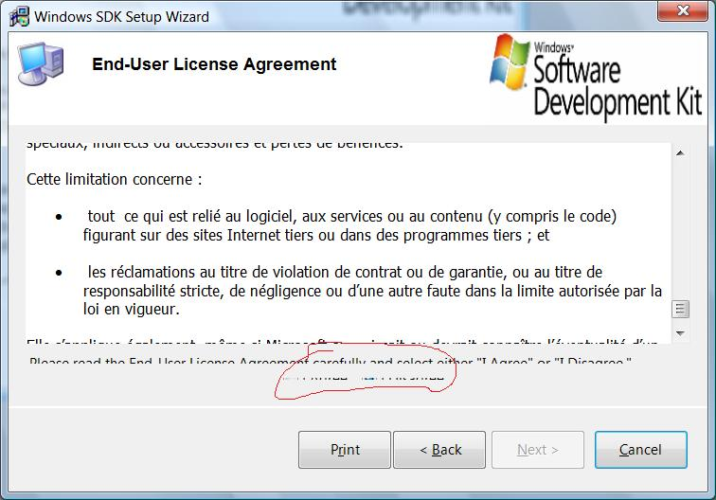
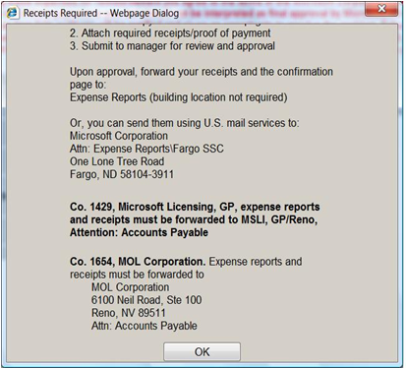
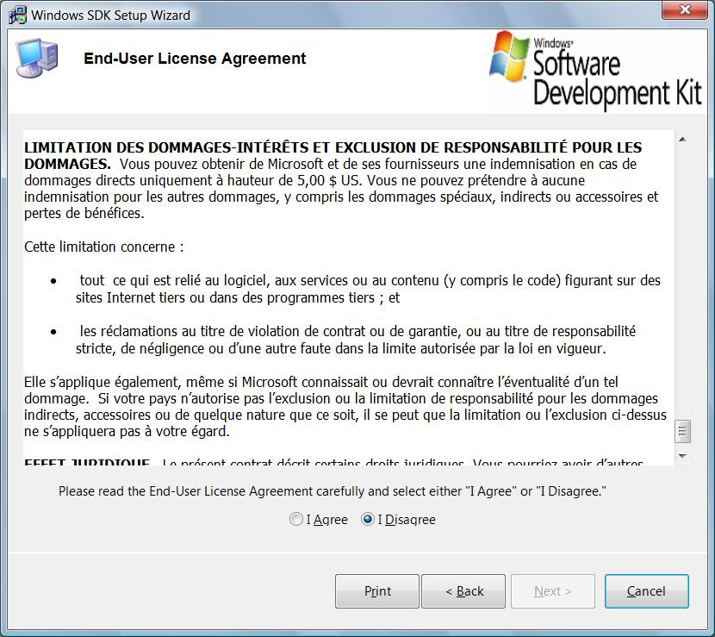
User Interface: High DPI

Slide 69
Networking
TCP/IP stack completely re-written from XP/WS03
The following elements are no longer supported
Firewall-hook driver functions / filter-hook driver functions
R-Series of tools – only available through services for Unix
IPX Protocol
The firewall hook APIs have been replaced with a fully documented way of filtering – Windows Filtering Platform (WFP)
Internal system calls and hooks removed
Network scanning, firewall, anti-virus apps that used internal system calls, data structures fail
http://msdn2.microsoft.com/en-us/library/aa364931.aspx
Notes:
2/18/2009 7:03 PM
69
© 2005 Microsoft Corporation. All rights reserved.
This presentation is for informational purposes only. Microsoft makes no warranties, express or implied, in this summary.

Slide 70
Networking: TCP/IP stack
Compound TCP introduced
TCP receive window auto-tuning introduced
IP v4 and v6 share a single stack
IP v6 addresses will be present and on by default
IPv6 Porting document…
http://msdn2.microsoft.com/en-us/library/ms738649.aspx
Checkv4.exe utility flags porting issues in source
Compiler flag – IPv6Strict
Functions and structures have been introduced to support IPv4 and IPv6 addresses
Use version agnostic APIs
Notes:
Compound TCP
Goal: prevent flooding of network by restricting data sent out
Old way, increase segments sent based on acknowledgements
Problem: could take lots of time to reach maximum throughput on high bandwidth (lots of potential segments), high latency (longer time to receive ack) networks (e.g. high bandwidth WAN)
Solution Compound TCP (CTCP)
More aggressive about size increase
Works hand in hand with Receive auto tuning below
monitoring delay variations and losses.
substantial performance gains for large bandwidth-delay product connections.
CTCP is enabled by default in computers running beta versions of Windows
Server 2008 and disabled by default in computers running Windows Vista.
You can enable CTCP with the netsh interface tcp set global
congestionprovider=ctcp command.
You can disable CTCP with the netsh
Interface tcp set global congestionprovider=none command.
Receive window auto-tuning
Goal: maximize throughput by looking at bandwidth delay product (bandwidth * round trip time – rtt) and app retrieve time
Old way: Can be dynamically set, but for all TCP connections and does not vary with network conditions – registry key also
New way: measures above continually and adjusts with changing conditions
Note Some Internet gateway devices and firewalls block packet flows because they do not correctly interpret the scaling factor used in TCP connections. Because of this, Internet Explorer in Windows Vista uses an initial scaling factor of 2. Other applications use a default initial scaling factor of 8. Microsoft is investigating changing the initial scaling factor for Internet Explorer-based connections to 8 in a future update of Windows Vista. Microsoft is working with the manufacturers of these devices so that they can be updated for compliance with TCP window scaling.

Slide 71
x64 Vista/WS08
64-bit drivers required
Digitally signed kernel mode drivers required
No upgrade path
16-bit subsystem removed
Watch out for 16-bit installers or older dependencies
WOW64 offers highly performing 32-bit compatibility
64-bit and 32-bit code cannot co-exist in the same process
Watch for necessary interactions with 64-bit code – e.g. monitoring apps, etc.
Windows Server R2 – 64 bit only
Notes:
2/18/2009 7:03 PM
© 2005 Microsoft Corporation. All rights reserved.
This presentation is for informational purposes only. Microsoft makes no warranties, express or implied, in this summary.
71

Slide 72
Winlogon and GINA
Winlogon credential extension re-architected
New Credential Provider API simplifies authentication
Support for custom GINA removed
Issues
Apps supporting custom login and authentication fail
Biometric devices
Custom VPN solution for XP
Smart Card readers
Mitigation
Update application to support new Winlogon architecture
Built in smart card authentication
Well documented in SDK

Slide 73
Windows Mail
Windows Mail is deprecated
CoStartOutlookExpress API is disabled
Binaries, .EML, .NWS will be retained
Entry points to Windows Mail/Contacts disabled
Protocol handlers will not be associated
File associations will not work w/ Windows mail
(.eml, .nws, .contact, .group, .wab, .p7c, .vfc)
Detect default mail handler, change code calling Windows mail API
Notes:
Windows mail is deprecated
photo gallery, Windows movie maker – are removed from Windows 7
Other mail API are deprecated, and will be removed later release; not all are deprecated, and these will continue to work fine

Slide 74
Discussion
Notes:
2/18/2009 7:03 PM
© 2005 Microsoft Corporation. All rights reserved.
This presentation is for informational purposes only. Microsoft makes no warranties, express or implied, in this summary.
74

